Slide 1
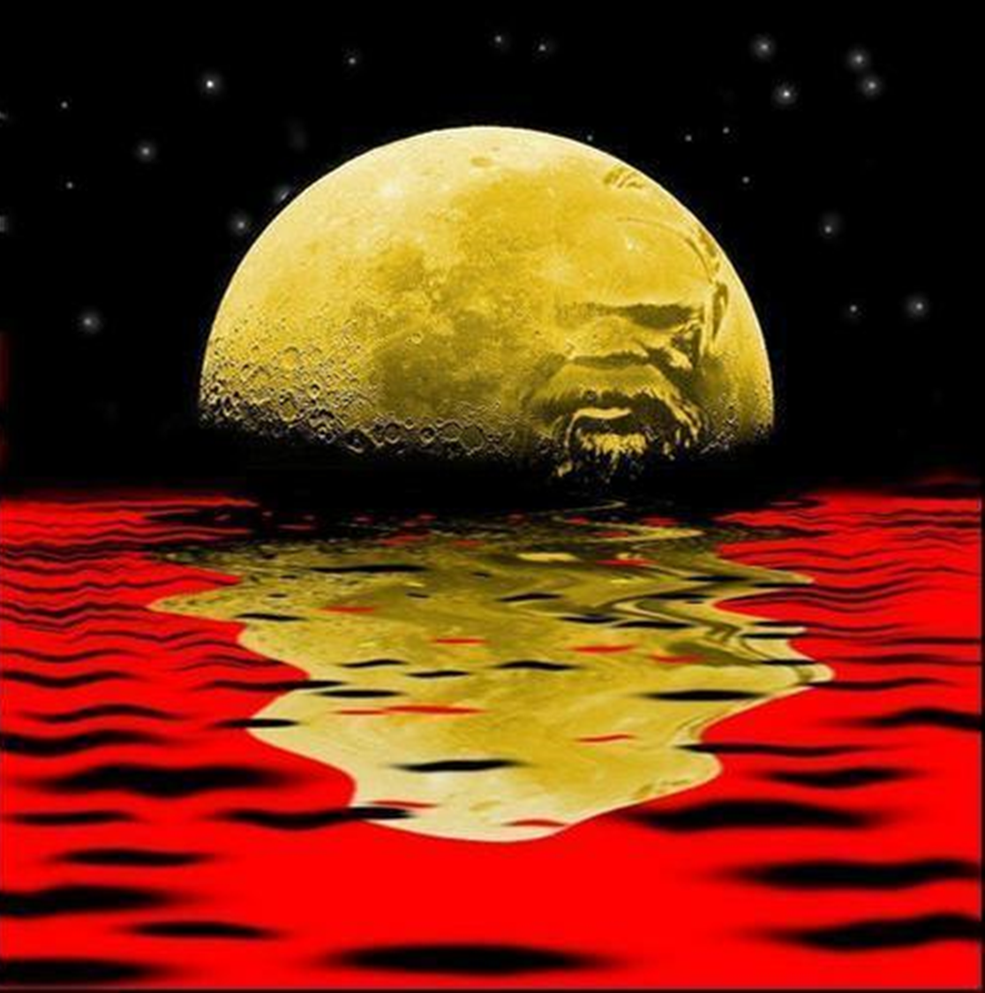
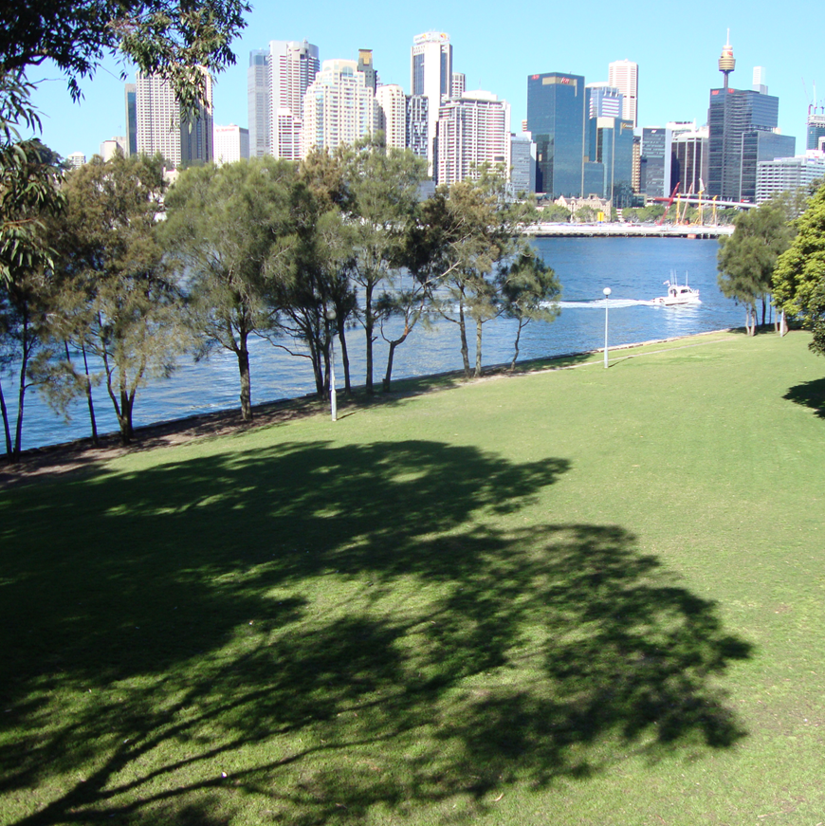

Self-determination and Autonomy
– Site Study
Survival Memorials
Top: Modern interpretation of the Aboriginal Flag source unknown
Bottom: Survival Memorial Site at Illoura Reserve (Site 1), picture by Bronwyn Touhy 2019

Slide 2

Protocols
Protocols for collaborating with Aboriginal and Torres Strait Islander Communities and engaging with Cultural works
NESA is committed to working in partnership with Aboriginal Communities and supporting teachers, schools and schooling sectors to improve educational outcomes for young people.
It is important to respect appropriate ways of interacting with Aboriginal Communities and Cultural material when teachers plan, program and implement learning experiences that focus on Aboriginal and Torres Strait Islander Priorities.
Indigenous Cultural and Intellectual Property (ICIP) protocols need to be followed. Aboriginal and Torres Strait Islander Peoples’ ICIP protocols include Cultural Knowledges, Cultural Expression and Cultural Property and documentation of Aboriginal and Torres Strait Islander Peoples’ Identities and lived experiences. It is important to recognise the diversity and complexity of different Cultural groups in NSW, as protocols may differ between local Aboriginal Communities.
Teachers should work in partnership with Elders, parents, Community members, Cultural Knowledge Holders, or a local, regional or state Aboriginal Education Consultative Group. It is important to respect Elders and the roles of men and women. Local Aboriginal Peoples should be invited to share their Cultural Knowledges with students and staff when engaging with Aboriginal histories and Cultural Practices.
This information needs to be read and understood before proceeding
https://curriculum.nsw.edu.au

Slide 3
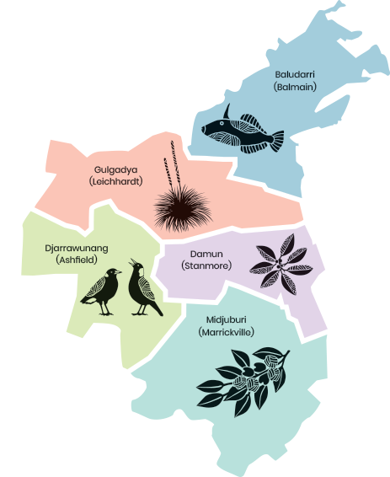
Disclaimer
Aboriginal and Torres Strait Islander peoples are advised this PowerPoint may contain names, works and images of Aboriginal and Torres Strait Islander peoples who are deceased.

Slide 4
Self-determination and Autonomy
– Site Study
Survival Memorials
Top: Modern interpretation of the Aboriginal Flag source unknown
Bottom: Survival Memorial Site at Illoura Reserve (Site 1), picture by Bronwyn Touhy 2019

Slide 5
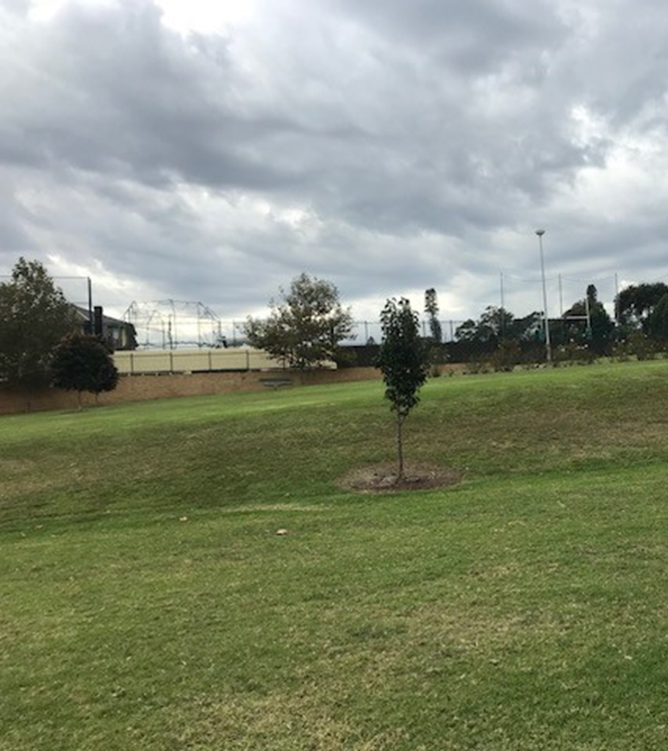
Inner West Council’s Aboriginal Survival Memorials
Idea was originated by Inner West Councillors in 2018
Original concept was to commemorate ‘Frontier Wars’ – Aboriginal resistance fighters to colonisation
Council consulted with the Aboriginal & Torres Strait Islander peoples and communities of the Inner West
Aboriginal & Torres Strait Islander peoples and communities proposed to commemorate the ‘oldest continuing living culture in the World’
It was suggested that three Survival Memorials, to be created to tell the story
Yeo Park Site – North side (Site 2) picture taken by Bronwyn Touhy 2019

Slide 6
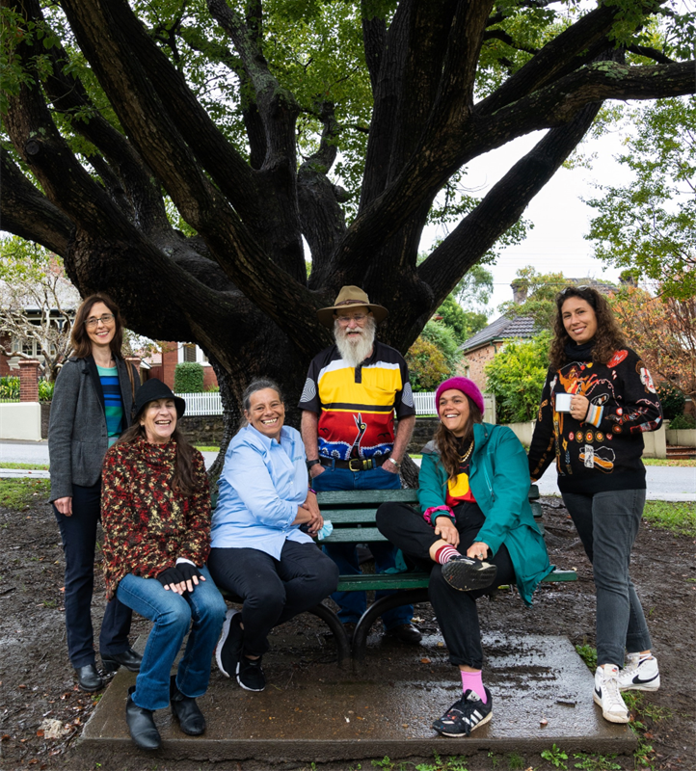
Aboriginal Community Engagement
Aboriginal & Torres Strait Islander community members from the left – Dr Katrina Thorpe, Janelle Scott, Deborah Lennis (Cultural Advisor IW) Uncle Allan Barnes, Maddison Gibbs & Nicole Monks photo taken by Ashleigh Rankin 2022
Forum discussion to begin – recommend to commemorate and tell the story of Survival for Aboriginal & Torres Strait Islander peoples.
Since the Dawn of Time
Reflection, Healing and Reconciliation
Resilience and Staying Strong
Site Visits – across the parks of the Inner West to decide best location for the memorials

Slide 7
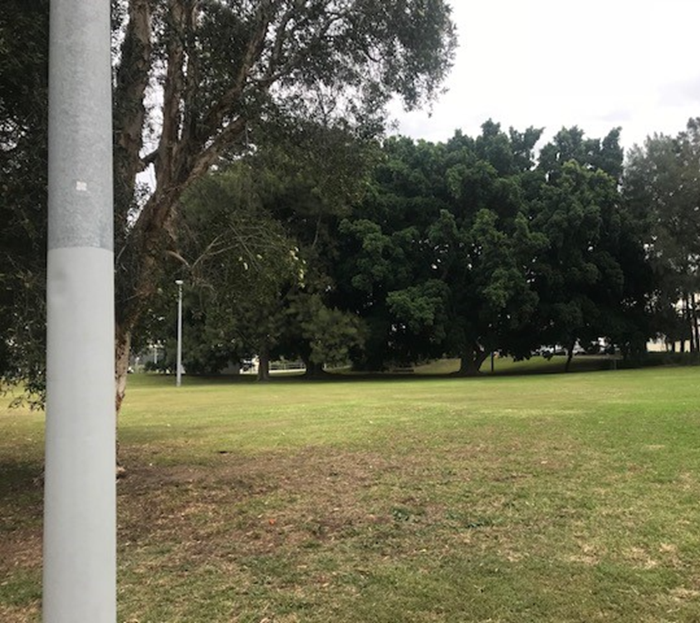
Selection Process
Recommendations to council
Three Survival memorial to be erected
Site 1 – Illoura Reserve Balmain East
Site 2 – Yeo Park Ashfield
Site 3 – Kendrick Park Tempe
Open Expression of Interest
(Aboriginal artists) recommended for all three Survival Memorials
Engage an Aboriginal curator
To develop the brief
Assist Council in the selection of Aboriginal artist/s
Kendrick Park – north/west Aspect (Site 3), picture by Bronwyn Touhy 2019

Slide 8
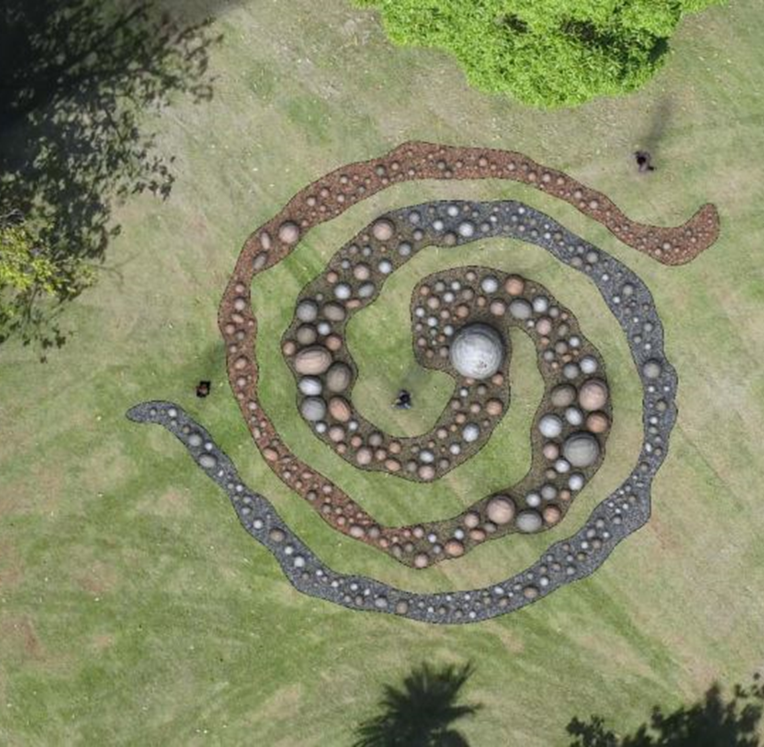
Selected Artist/s
Through the EOI process
Applications were assessed via a panel
Aboriginal community engagement
Winners
Nicole Monks & Maddison Gibbs (Mili Mili)
Theme/Concept of design – Connection to Country
Winning Design Concept – Artists Nicole Monks & Maddison Gibbs (Mili Mili) 2021

Slide 9
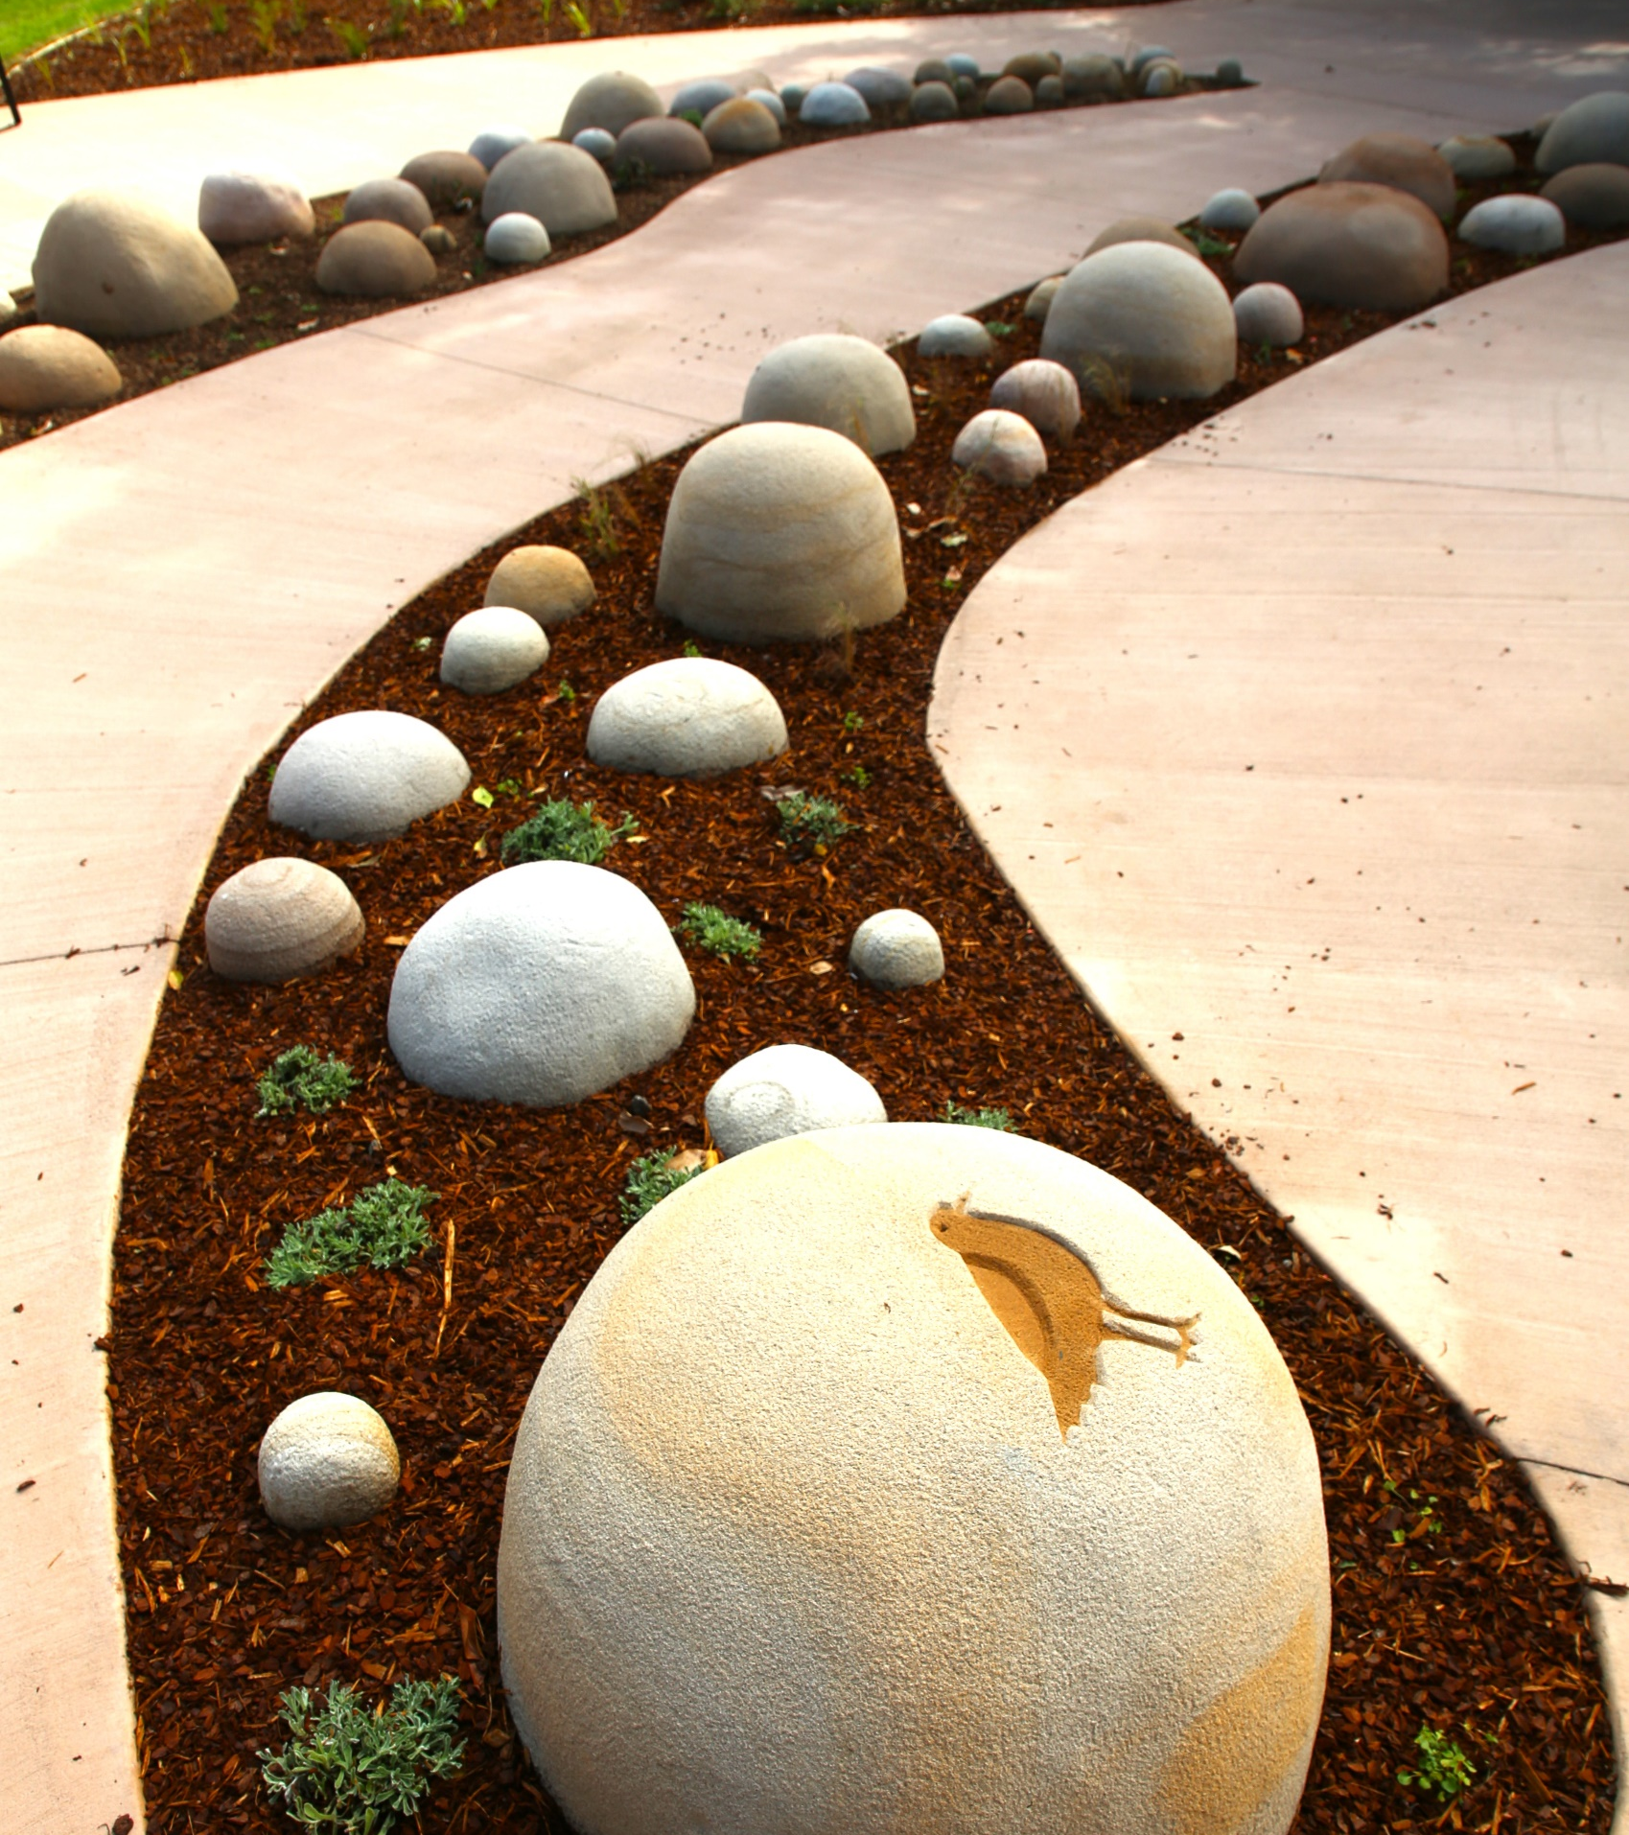
Community Engagement
Council did a 1000+ letterbox drop
Discussion with residents and the wider community of the Inner West LGA
Issues that arose
  Landscaping
  Drainage
  Loss of greenspace/grass
  Loss of ‘heritage’ roses
  No more made-made infrastructure (concrete)
Breathe – Nicole Monks & Maddison Gibbs. Photo by Shane Rozario 2024

Slide 10
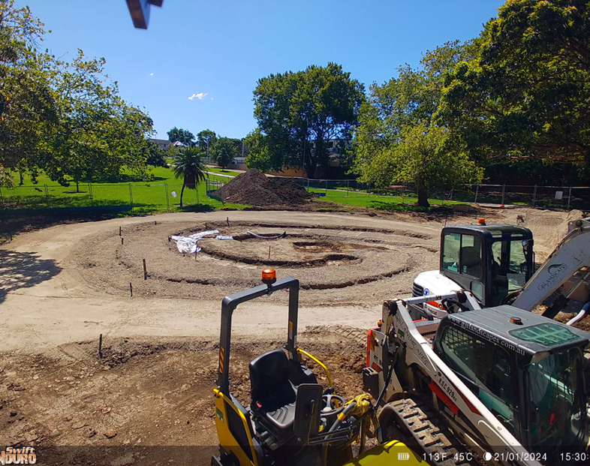
Breaking Ground
Survival memorials were a commitment in the Reconciliation Action Plan (RAP)
New components to the park
Drainage
Landscaping
Seating
Mature Trees
There was no loss during construction of the memorial of these
No trees were removed
No loss of roses
Dirt and grass recycled within the park
Construction of Breathe worksite –part of the timelapse photography of the process.

Slide 11
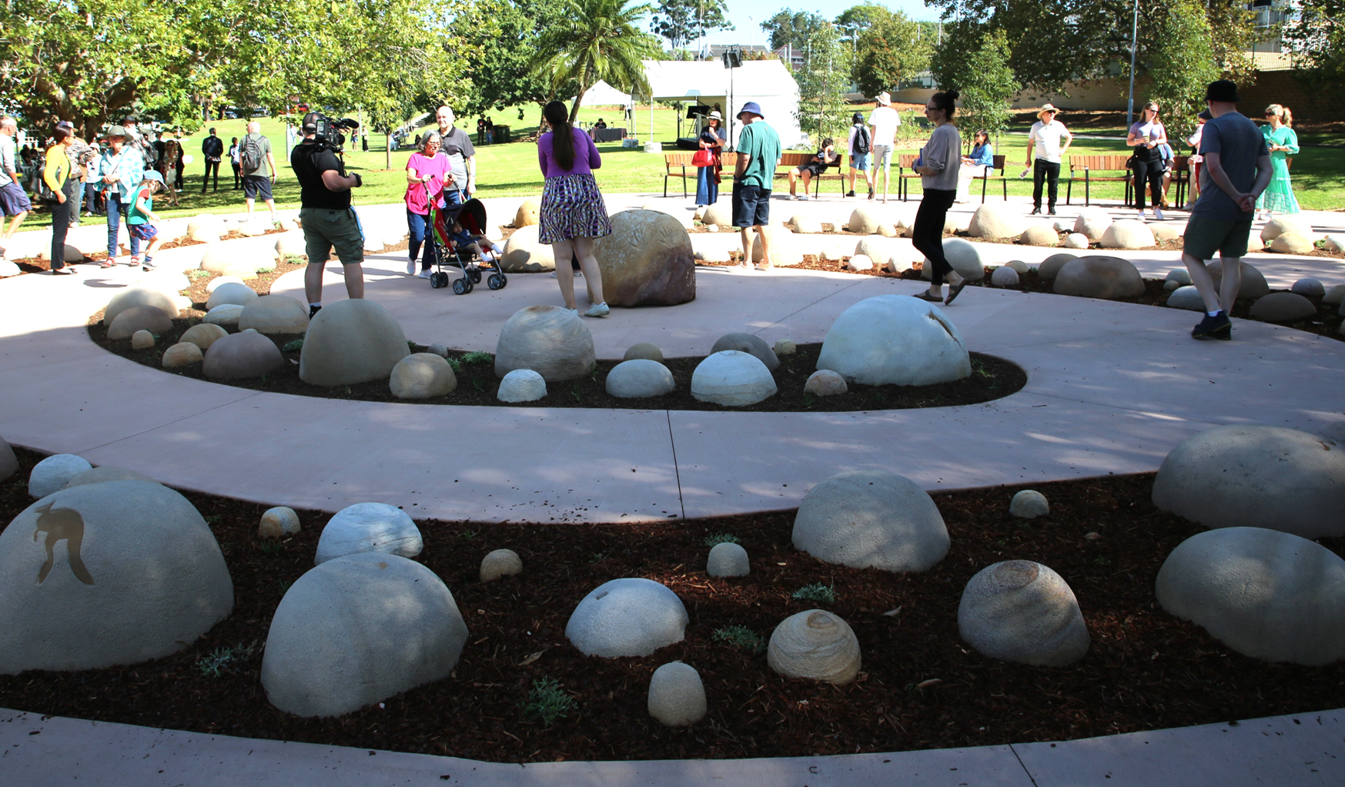
Opening day
March 2024
https://youtu.be/a8oKNd3DsvI
Community enjoying Opening Day of Breathe – by Nicole Monks & Maddison Gibbs picture taken by Shane Rozario

Slide 12
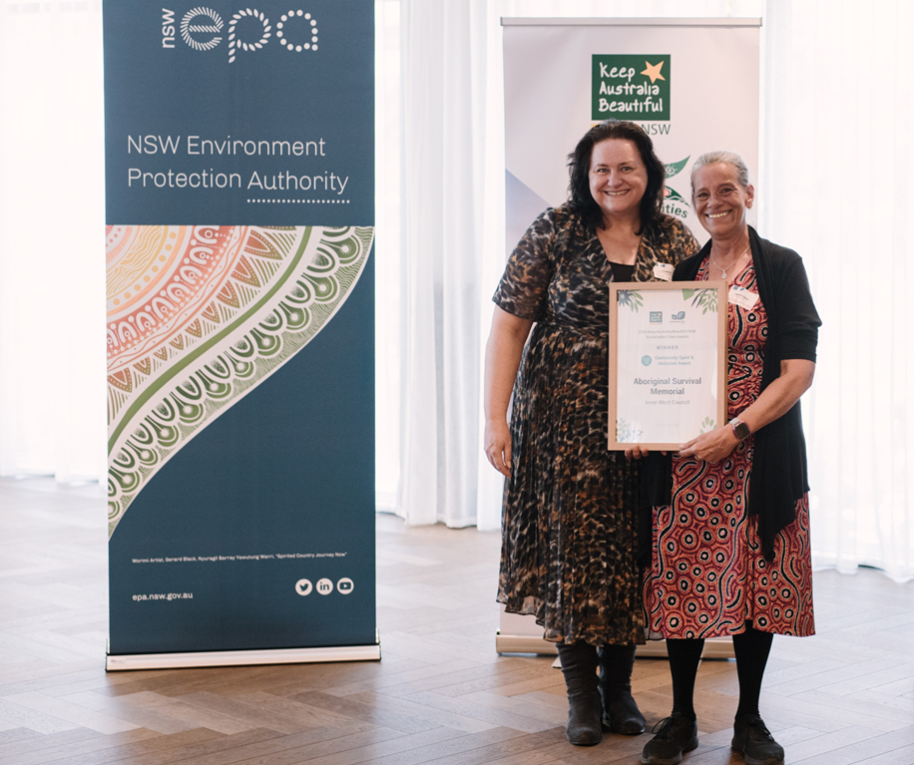
Current Awards
Won for ‘Breathe’
Good Design Awards
– Won by Nicole Monks & Maddison Gibbs
Keep Australia Beautiful Community Spirit Award
– won by Inner West Council
Keep Australia Beautiful Authority (EPA) Awards held at Penrith City Council 2024 picture taken by Simon Wa& NSW Environmental tts 2024

Slide 13
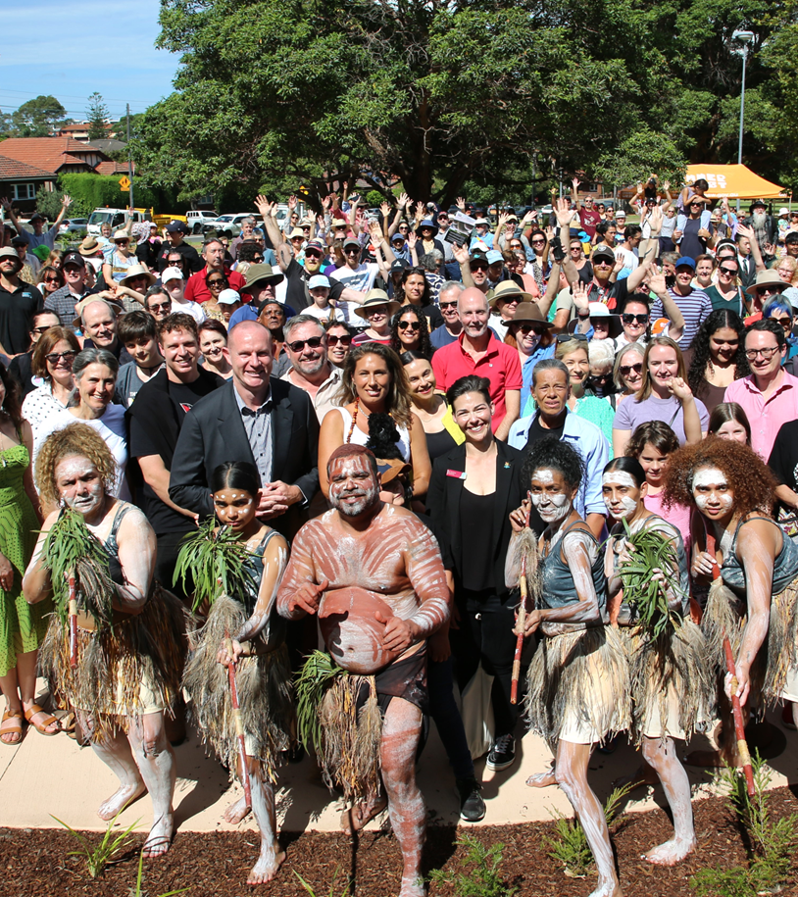
Current Community Use
Aboriginal community, Councillors, Council Staff & Residents at the opening of Breathe March 2024 picture taken by Shane Rozario
NSW Government Departments have had staff training regarding connecting to Country
Inner West residents walk, rest, contemplate, reflect within the Memorial
Inner West staff have chance to sit and reflect enjoy the sunshine
Local Schools can arrange excursions and lessons to be held at the Memorial
Quote – Mili Mili
‘Connecting with the past, responding to the present to create a beautiful future for all’ www.milimili.com.au/services

Slide 14
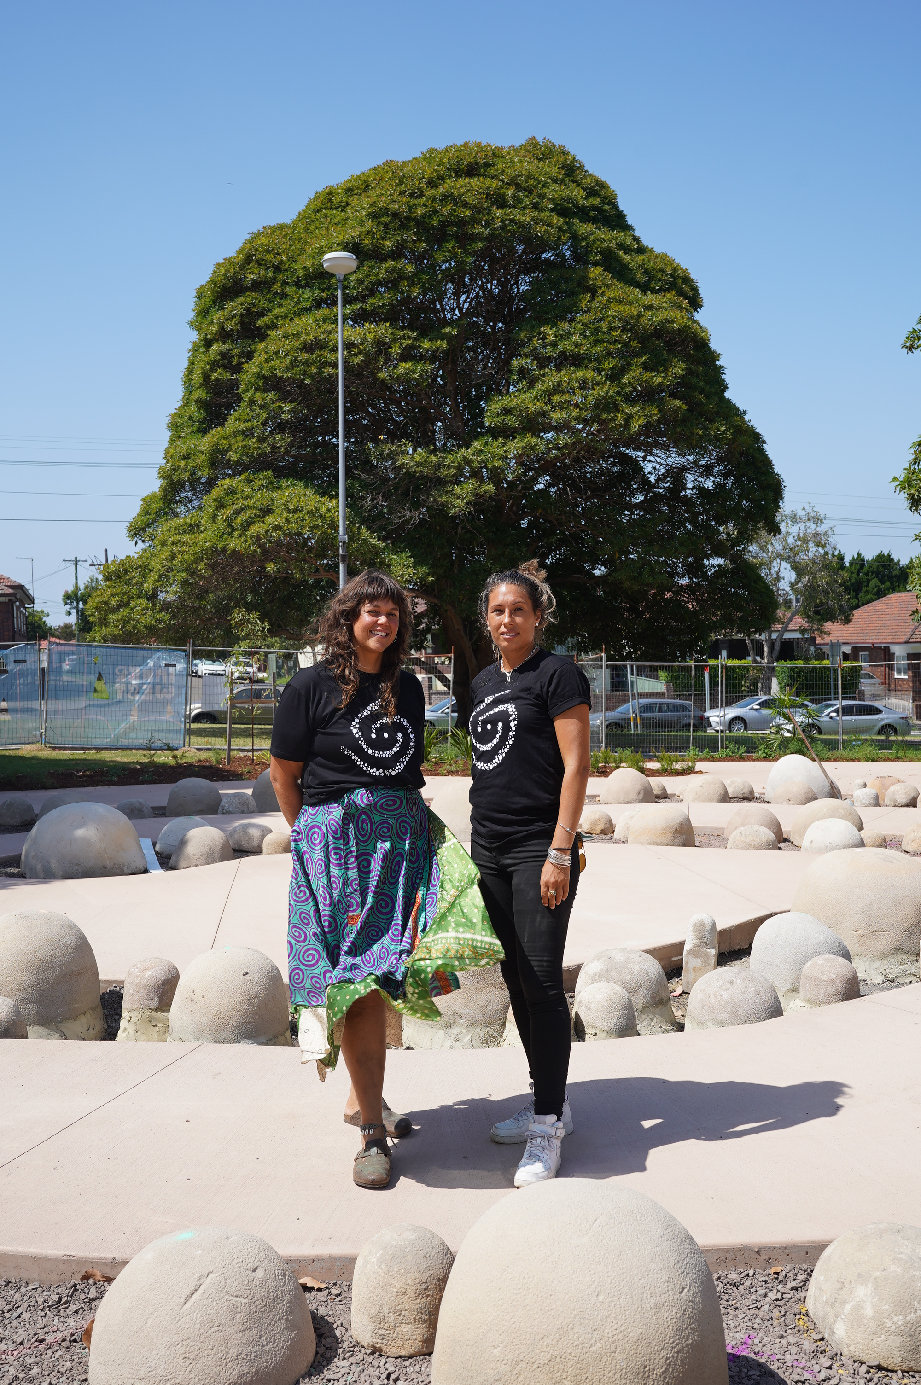
Connection to Country
Proudly produced by Ashwater Films, this short film documents the work "Breathe" by Nicole Monks and Maddison Gibbs, commissioned by Inner West Council.
https://www.youtube.com/watch?v=r-cFM-3L38l&t=2s
Maddison Gibbs & Nicole Monks at Breathe picture taken by Ashleigh Rankin 2024

