Slide 1
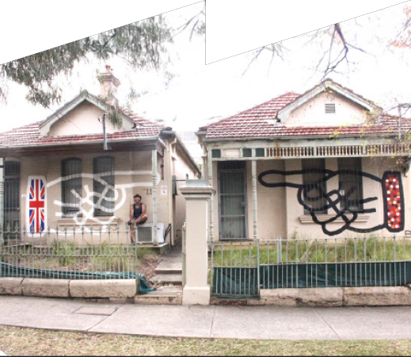

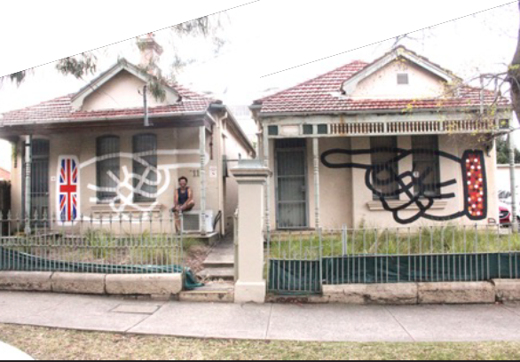
Aboriginal Identities in the Inner West Local Government Area
Mural by Blak Douglas, ‘What’s your point?’ created for the 2015 Leichhardt- Fringe Festival picture by Bronwyn Tuohy

Slide 2

Protocols
Protocols for collaborating with Aboriginal and Torres Strait Islander Communities and engaging with Cultural works
NESA is committed to working in partnership with Aboriginal Communities and supporting teachers, schools and schooling sectors to improve educational outcomes for young people.
It is important to respect appropriate ways of interacting with Aboriginal Communities and Cultural material when teachers plan, program and implement learning experiences that focus on Aboriginal and Torres Strait Islander Priorities.
Indigenous Cultural and Intellectual Property (ICIP) protocols need to be followed. Aboriginal and Torres Strait Islander Peoples’ ICIP protocols include Cultural Knowledges, Cultural Expression and Cultural Property and documentation of Aboriginal and Torres Strait Islander Peoples’ Identities and lived experiences. It is important to recognise the diversity and complexity of different Cultural groups in NSW, as protocols may differ between local Aboriginal Communities.
Teachers should work in partnership with Elders, parents, Community members, Cultural Knowledge Holders, or a local, regional or state Aboriginal Education Consultative Group. It is important to respect Elders and the roles of men and women. Local Aboriginal Peoples should be invited to share their Cultural Knowledges with students and staff when engaging with Aboriginal histories and Cultural Practices.
This information needs to be read and understood before proceeding
https://curriculum.nsw.edu.au

Slide 3
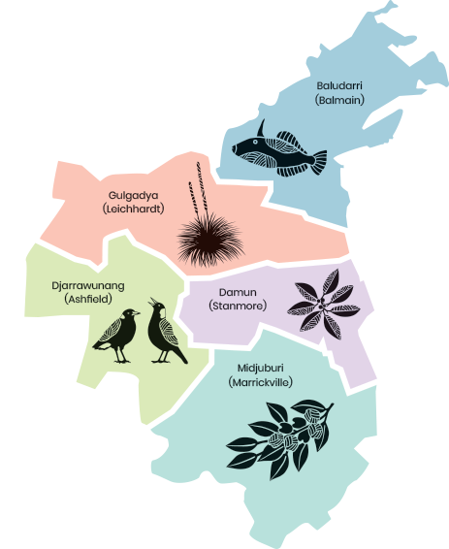
Disclaimer
Aboriginal and Torres Strait Islander peoples are advised this PowerPoint may contain names, works and images of Aboriginal and Torres Strait Islander peoples who are deceased.

Slide 4
Aboriginal Identities in the Inner West Local Government Area
Mural by Blak Douglas, ‘What’s your point?’ created for the 2015 Leichhardt- Fringe Festival picture by Bronwyn Tuohy

Slide 5
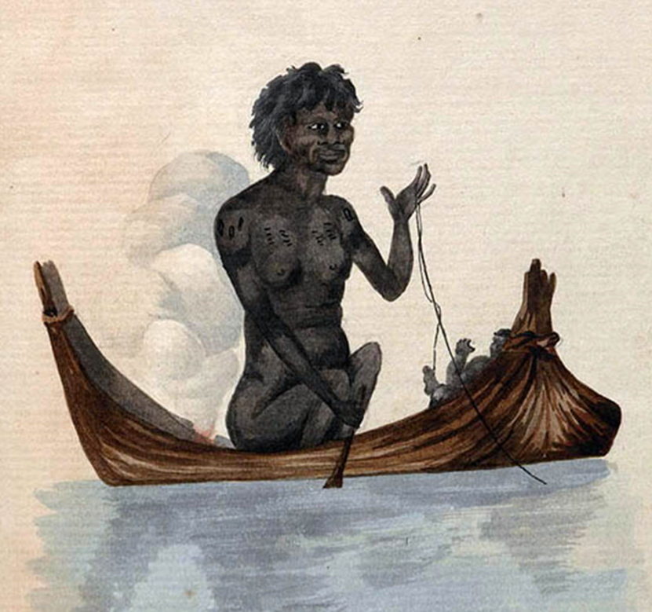
Z
Welcome to Country
Given by a Traditional Custodian/Elder of the Country on which the ‘Welcome’ takes place
Community Elder nominated by the Local Aboriginal Lands Council
Recognised as a local Elder
Aboriginal woman with her baby, in a canoe fishing with a line c1805, courtesy Mitchell Library, State Library of NSW (PXB 513, f.12)

Slide 6
Z
Acknowledgement of Traditional Custodians to Country
Here is an Acknowledgement that
could be used:
‘I would like to Acknowledge the Gadigal and Wangal peoples, who are the Traditional Custodians of this land. I would like to pay my respects to Aboriginal Elders past and present
and pay my respects to
any Aboriginal peoples
here today’.
Done by an Aboriginal person from a different community
Done by any non-Aboriginal person

Slide 7
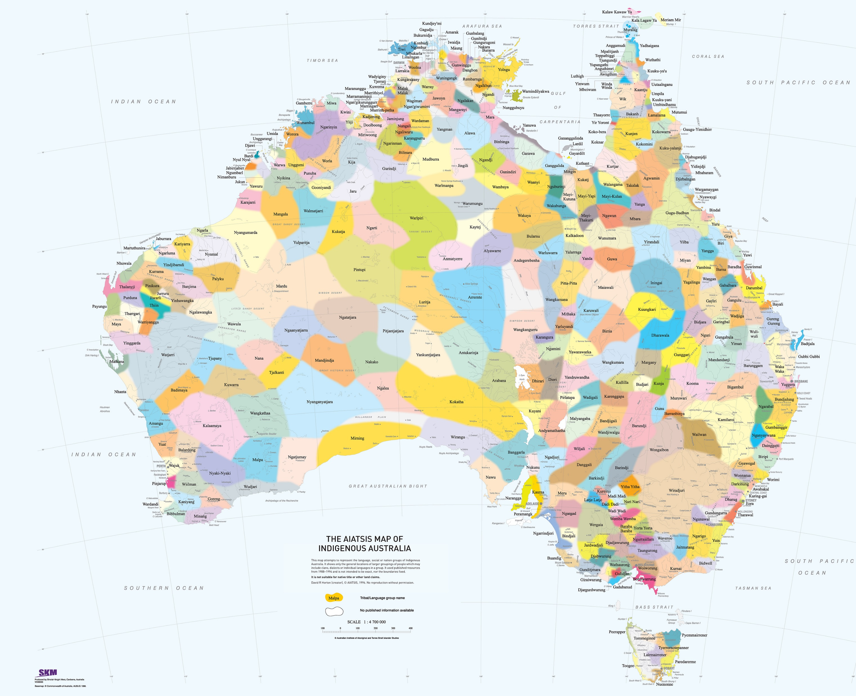
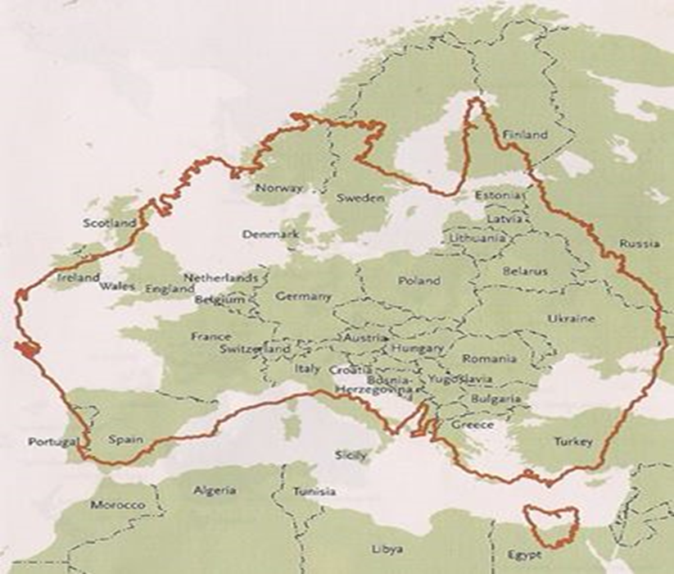
Z
Aboriginal Language Groups throughout Australia
Two distinct groups of Indigenous peoples in Australia
Aboriginal peoples (mainland and few small islands)
Torres Strait Islander peoples (Islands between Papua New Guinea and the Northern tip of Australia
Aboriginal & Torres Strait Islander cultures are the oldest continuing cultures in the world.
Archaeological evidence demonstrates that Aboriginal peoples have been here 65,000 years.
Aboriginal Groups throughout Australia differ in many ways including:
Language, Customs, Beliefs
Music, Dance, Art forms
Ceremonies, Kinship systems
This map attempts to represent the language, social or nation groups of Aboriginal Australia. It shows only the general locations of larger groupings of people which may include clans, dialects or individual languages in a group. It used published resources from 1988-1994 and is not intended to be exact, nor the boundaries fixed. It is not suitable for native title or other land claims. Source David R Horton (creator), AIATSIS, 1996. No reproduction without permission.
To purchase a print version visit: www.aiatsis.ashop.com.au.
Map of Europe inside Australia – deigned by Deborah Lennis 2007

Slide 8
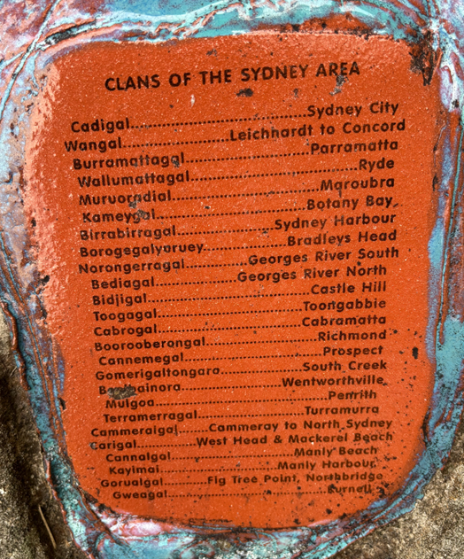
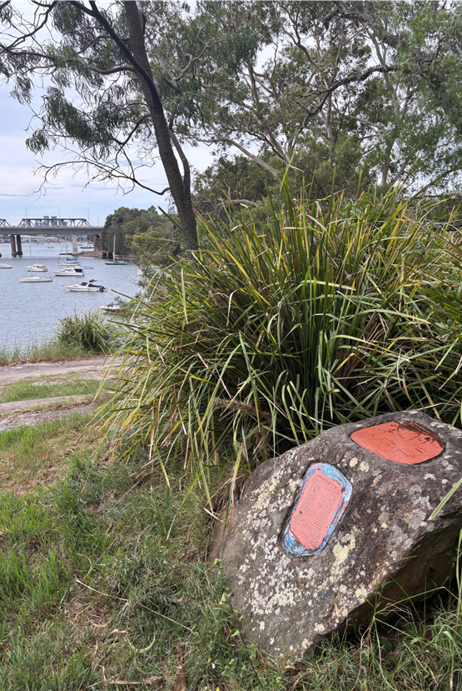
Z
Sydney Basin Aboriginal Clan Groups
Lands boarded by the 3 rivers
  Hawkesbury River – North
  Nepean River – West
  Georges River – South
  Coastline – East
29 different clans and languages spoken
Callan Park in Rozelle looking towards the Iron Cove Bridge. “Clans of the Sydney Area” signage created by Joe Hurst 1998 photos taken by Katrina Thorpe 2025

Slide 9
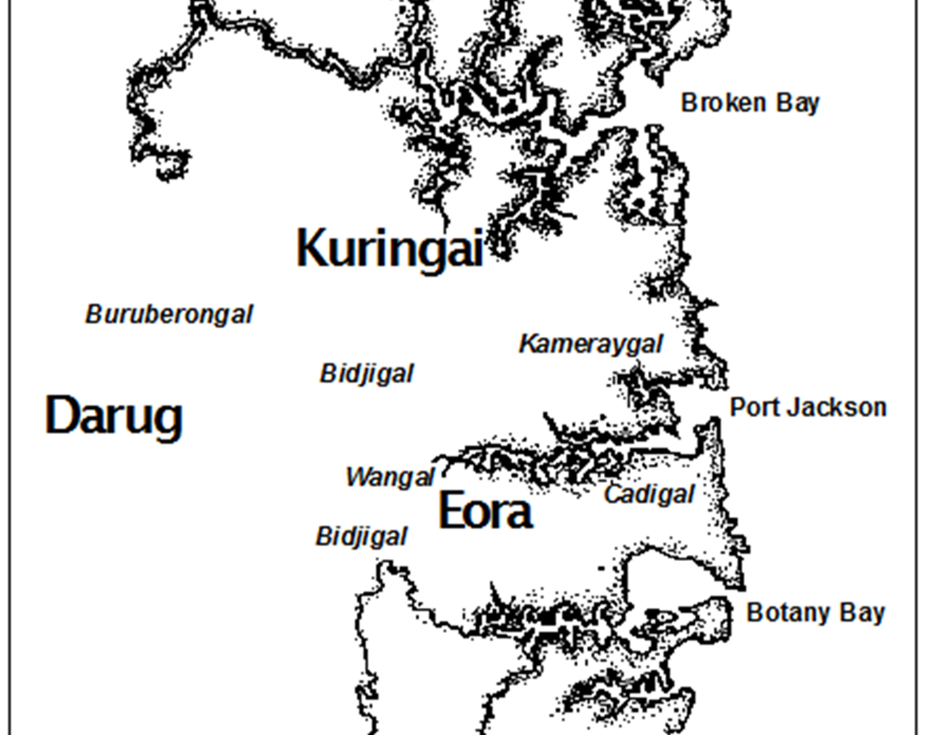
Z
Traditional Custodians of the Inner West Council Local Government Area
Traditional resident of the Inner West LGA were the
Gadigal
exact boundaries are unknown along the south side Port Jackson to about Petersham
Wangal
Petersham along the southern shore of the Parramatta River to about Rosehill
Map of Aboriginal clans Sydney Basin – Source unknown

Slide 10
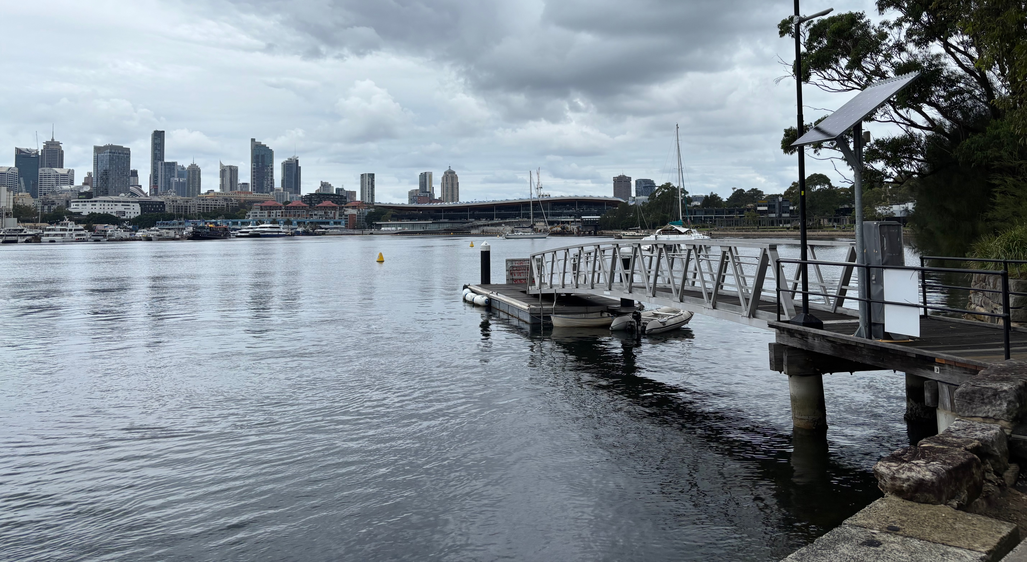
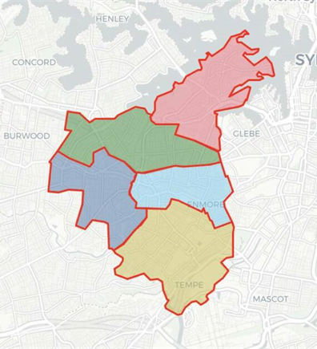
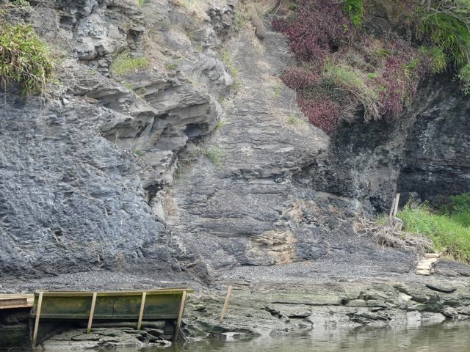
Z
Unique Country
Aboriginal & Torres Strait Islander peoples have a unique relationship to land, waterways & sky
It is not just soil & rock, it is a wholistic environmental approach, to sustain so therefore it is sustained by people & culture
Marrickville to Lilyfield into Ashfield in the west, Ashfield Shale overlaying Hawkesbury Sandstone dating back approx. 242-247 million years ago
Approximately 18,000 years ago
  Sea levels were 110-113 meters lower than today
  Eastern coastline was 15 kilometers further out to sea than present
Top: Blackwattle NSW – picture taken by Katrina Thorpe 2025
Left: Inner West Council Wards www.tallyroom.com.au/
archive/nswcouncil2024/innerwest2024
Bottom: Ashfield shale – www.step.org.au

Slide 11
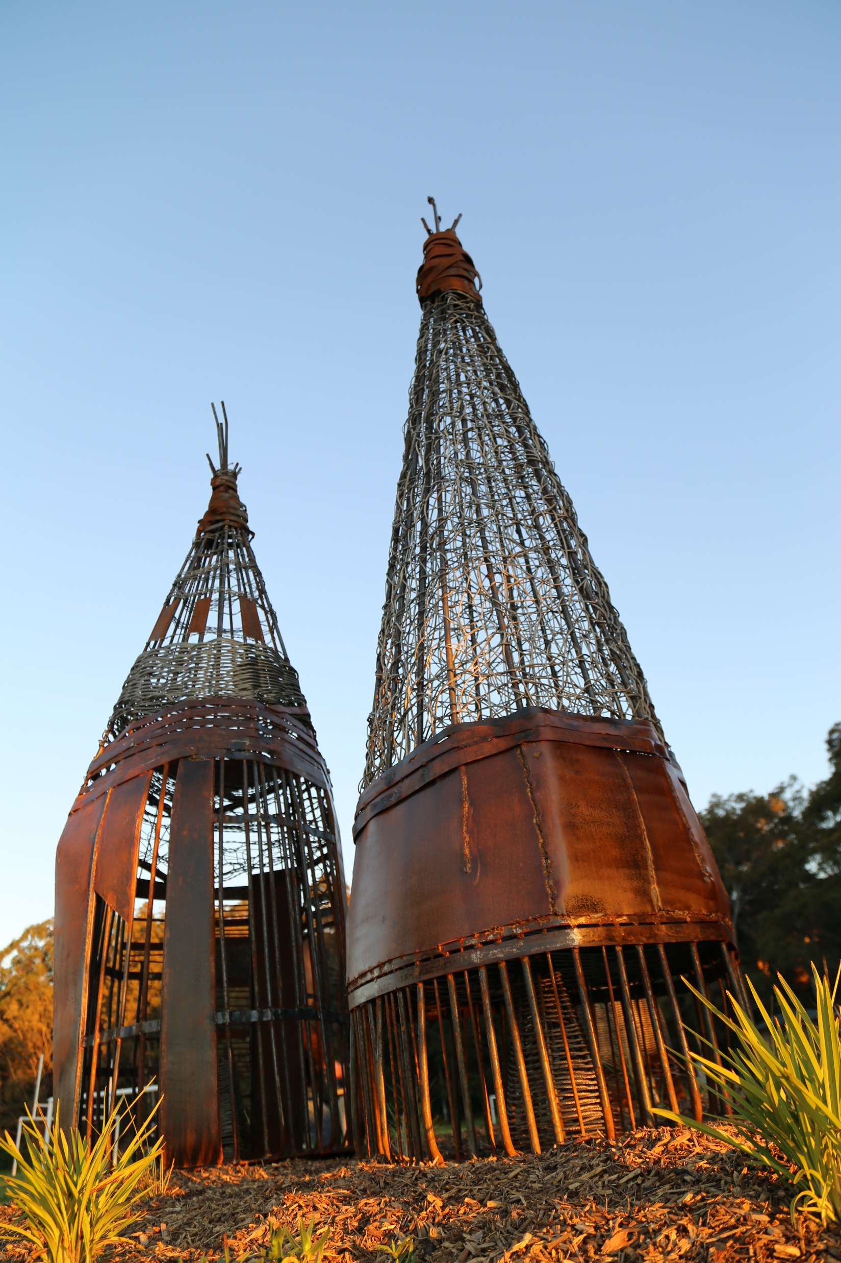
Unique History
Land, water and sky is at the core of Aboriginal peoples Spirituality
It is responsibility to look after the spirituality of the environment for wellbeing of Country
This is passed through ‘Traditional Lore’
Resistance Fighters
1790-1810 clans of Sydney undertook a campaign of resistance
Lead by Pemulwuy of the Bidgigal language group
Pemulwuy speared John McIntyre at what is now Marrickville Golf and Community Club
Cook observed Aboriginal peoples all the way along the coast
Noted ‘no fix’d habitations’ or ‘cultivated grounds’
Claimed the land ‘terra-nullius’ land that belong to no-one
This changed the landscape
  Trees were cut down
  Access to land and water denied as fences were built
  Overuse of food supplies
Diseases such as smallpox, measles and influenza was introduced
Gadigal/Wangal Wayfinding Project 2019 ‘Fish Traps’ by Edwards Clarke picture taken by Barbara 2019 Location King George Park, Manning Street Rozelle Baludarri (Leather Jacket) Balmain Ward

Slide 12
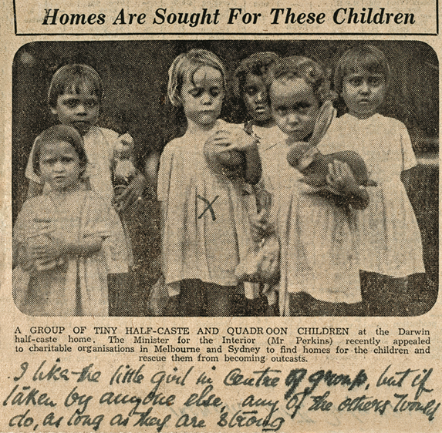
Z
Stolen generations
Australia between 1910 – 1970’s
Removed many Aboriginal and Torres Strait Islander children from their families
Children became known as the ‘Stolen Generations’
Removals were based on Assimilation policies, which claimed that Aboriginal & Torres Strait Islander lives would be improved in they became part of white society
Assimilation policies focused on the children as they were considered more adaptable
Separation - Ruth's Cherbourg Mission Story | Australians Together Video 4.12m
“I like the little girl in centre of group, but if taken by anyone else, any of the others would do, as long as they are strong”.
Homes Are Sought for These Children, 1934 Reproduction of a 1934 newspaper clipping. Image courtesy of the National Archives of Australia.

Slide 13
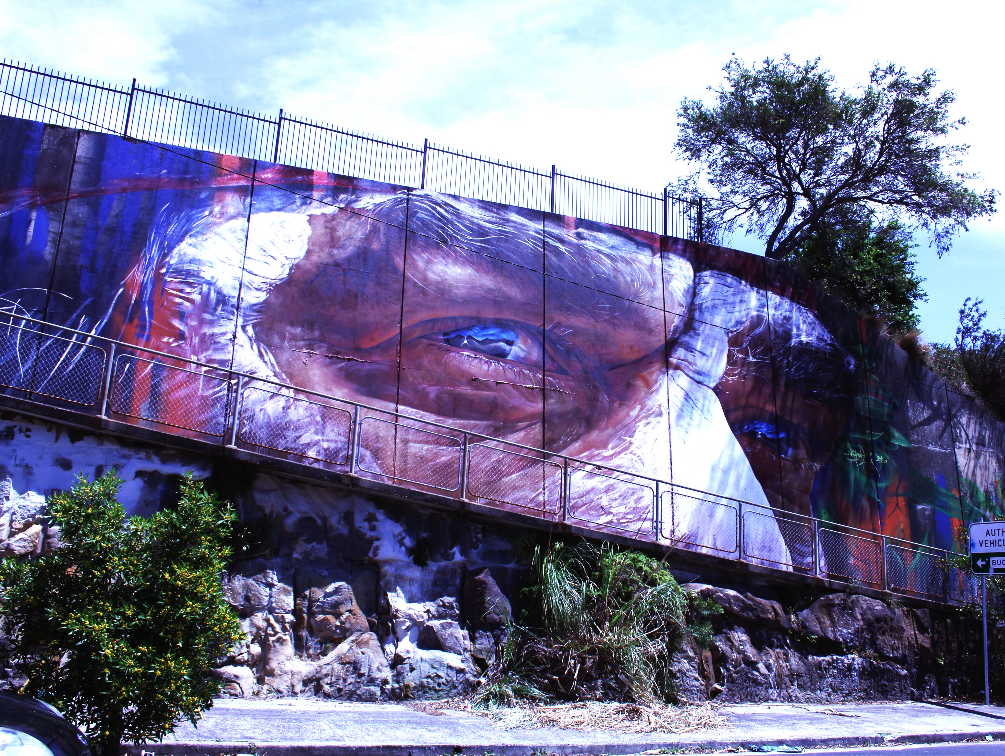
Z
Aboriginal & Torres Strait Islander Community of the Inner West Local Government Area (IWLGA)
Inner West Council has a long history and association with Aboriginal and Torres Strait Islander residents
2021 Census statistics for Inner West Council LGA
Non-indigenous population = 173,585
Aboriginal and Torres Strait Islander population = 2,172
Status not stated = 7,066
Inner West Council Area Population 2021
Aboriginal & Torres Strait Islander
Aboriginal persons eyes (Phillip Butler) – 10-year anniversary of ‘Wall to Wall’ artist Adnate 2015 Location: Roberts St Balmain
Not Stated
Non-Indigenous
www.abs.gov.au/census/find-census-data/quickstats/2024/LGA14170p

Slide 14
Z
Comparative Statistics for Inner West Council – 2021 Census
Comparative Statistics
Unemployment
Inner West LGA in the top 20 prosperous communities in Australia
Pockets of disadvantage, poverty and housing stress
2021 Census comparative facts about the Inner West
1.2% residents Aboriginal & Torres Strait Islanders (slide before)
NB: all numbers on this slide are percentages %
Rented Dwellings
Public Housing
Home Ownership
https://www.abs.gov.au/census/find-census-data/quickstats/2024/LGA14170

Slide 15
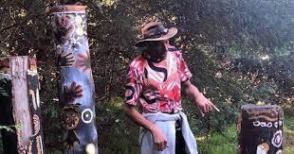
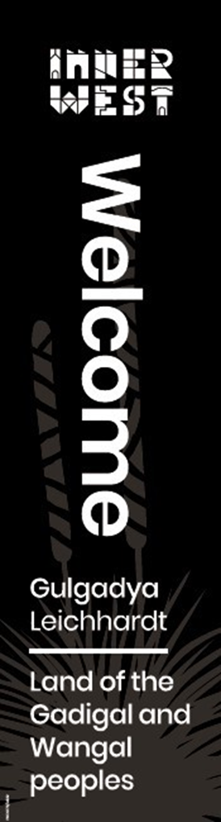
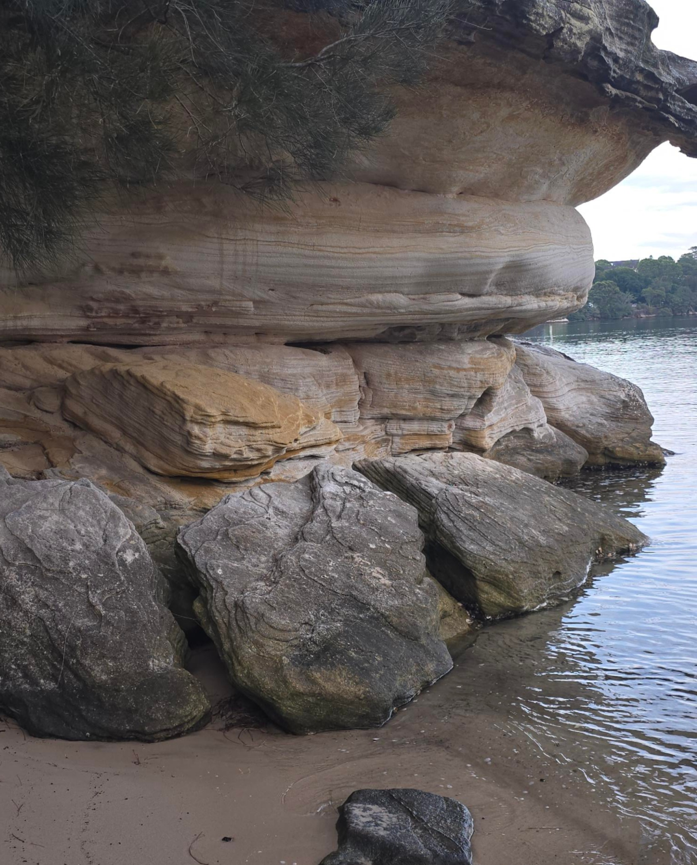
Z
Council Connections
2x full time Aboriginal staff dedicated to
working with
Advocating for
Acknowledging histories
Celebrating cultures of our Aboriginal & Torres Strait Islander communities
Terry Lennis (D’harawal) horticulturalist Bush Tucker Tour 2022 Cooks River for History Week IWC Libraries
Several sites of significance in the Inner West
Callan Point
  Shell middens approx. 4,500 years old
  Sheltered areas near the water
Cooks River – Kendrick Park
  Intact shell middens
  Stone artefacts (axe) to remove bark to make ‘nawi’ (canoe)
Callan Point Rozelle – picture taken by Tony Connor 2025
Council’s Ward Street Flags

Slide 16





Z
Council Wards
2018 Council resolved to name the Council Wards
Baludarri
(Leather Jacket)
Balmain Ward
Gulgadya
(Grass Tree)
Leichhardt Ward
Midjuburi
(Lilypily)
Marrickville Ward
Damun
(Port Jackson Fig)
Stanmore Ward
Djarrawunang
(Magpie) Ashfield Ward
All images for the Council Wards were created by Mumbulla Creatives for Inner West Council .

Slide 17
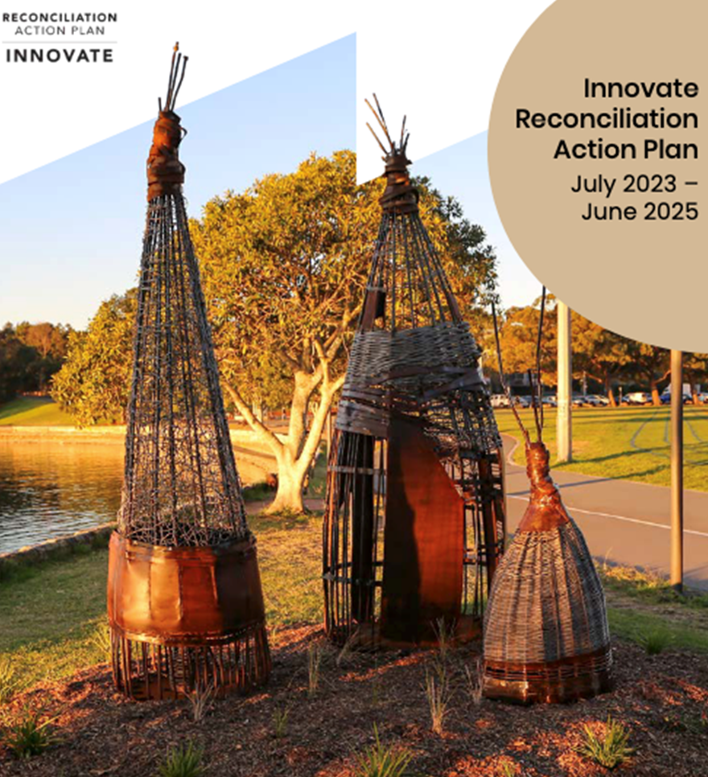
Council Commitments
Council is recognising Aboriginal culture and identity through:
Dual naming of places
Deeper understanding of archaeology through new research
Understanding Country through walks, landscape/park redevelopment
Aboriginal & Torres Strait Islander Local Democracy Group (LDG)
Policies and documents
  Reconciliation Action Plan (RAP)
  Cultural Strategic Plan
  Biodiversity Strategy
Welcome to Country by local Elders
Aboriginal design for the Council Branding

Slide 18
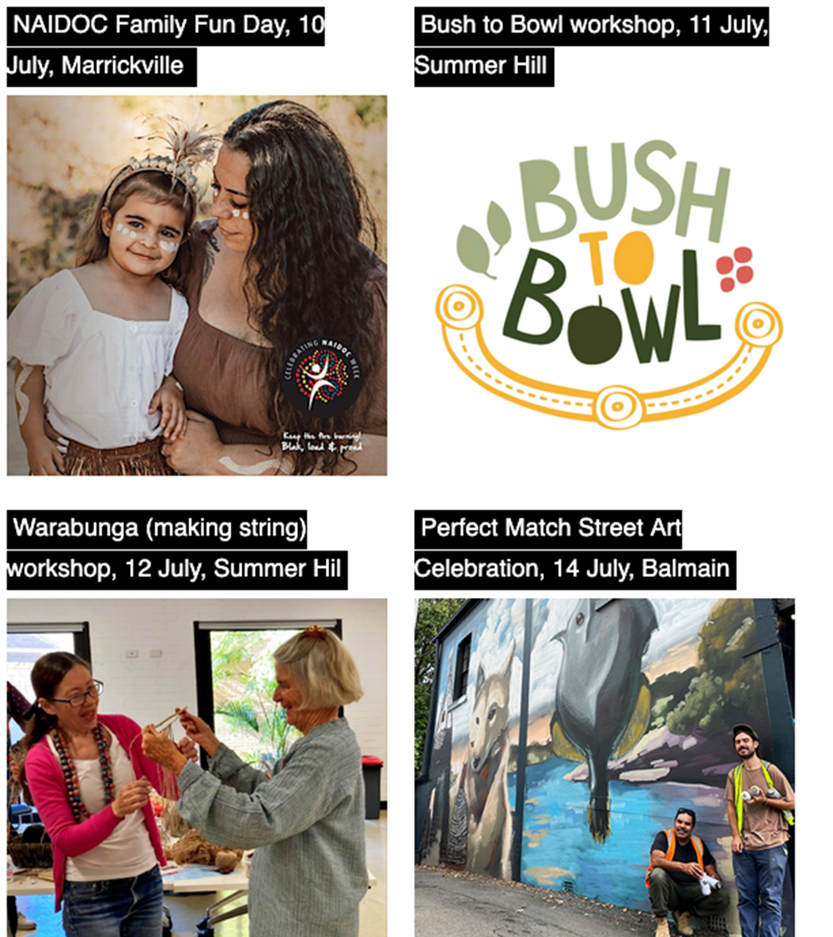
Council’s Aboriginal & Torres Strait Islander Annual Events
National Reconciliation Week
Celebrated annually from 27th May (successful 1967 Referendum) to 3rd June (High Court Mabo Case decision)
See Self-Determination & Autonomy PowerPoint for more information
The Pauline McLeod Awards (PMA’s)
Award ceremony recognising ‘silent achievers’ who work diligently in promoting Reconciliation through selfless acts.
The PMA’s are part of 3 Inner West annual Community Awards
NAIDOC Week (National Aboriginal and
Islander Day of Celebration)
Between the first Sunday and second Sunday of July
Council also celebrates Aboriginal culture, history and heritage through many other events annually
For further information check Council’s website often at: https://www.inerwest.nsw.gov.au/explore/whats-on#/
Celebrating Aboriginal Culture and Events Inner West 2024

Slide 19
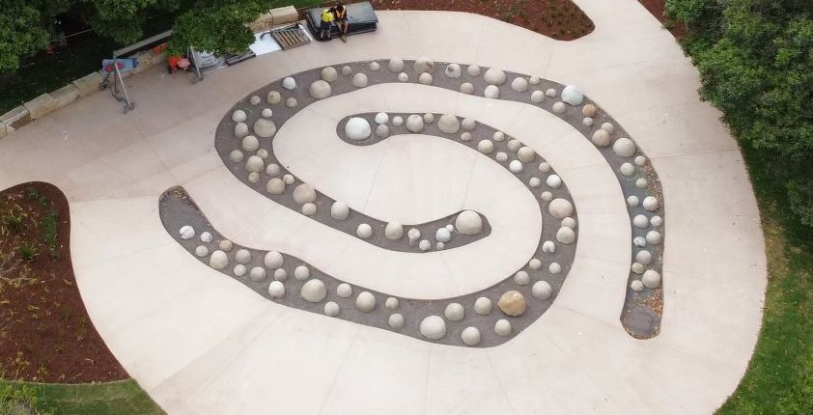
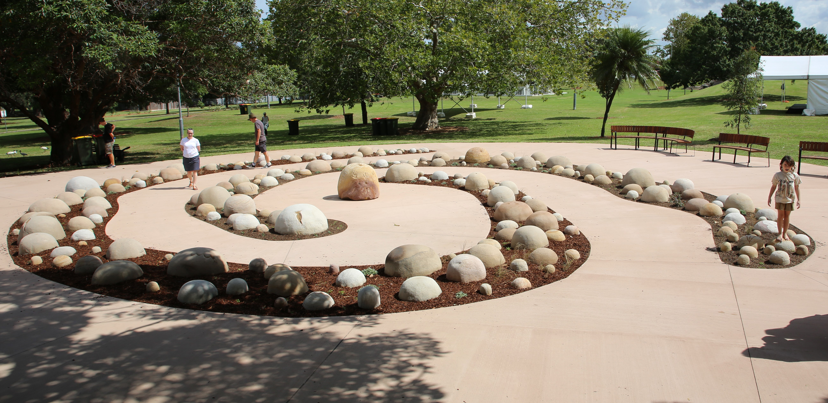
Z
Council’s Infrastructure Commitments
Council has committed to installing 3 Survival Memorials across the LGA
Telling the story of survival, resilience, autonomy
Chosen sites
  Illoura Reserve – Balmain East
  Yeo Park – Ashfield
  Kendrick Park – Tempe
Opening Day March 2024 picture by Shane Rizzrio
https://youtu.be/a8oKNd3DsvI
Drone aerial shot of ‘Breathe’ by Nicole Monks & Maddison Gibbs at Yeo Park New Canterbury Road Ashfield

Slide 20
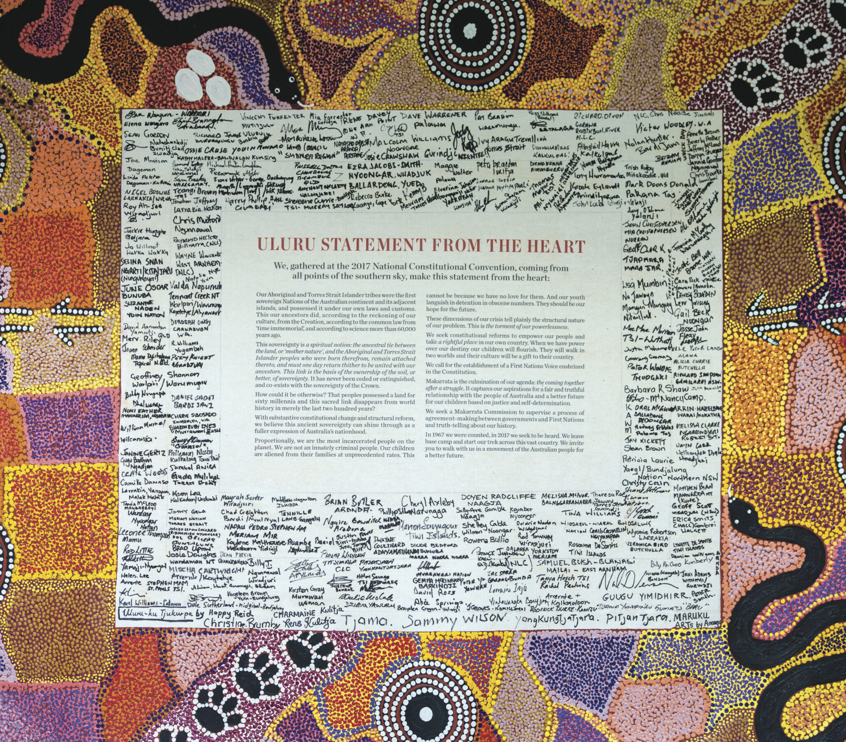
Z
Uluru Statement From The Heart
2022 Council adopted the Uluru Statement From The Heart and all its principles
  Voice
  Treaty
  Truth
It was an invitation from Aboriginal & Torres Strait Islander peoples to all Australians to walk together and build a better future
Council did ‘Walk Together Training’ for over 1,100 residents
Referendum was held October 2023 to give a ‘Voice in Parliament’
Failed Referendum 60.6% Australians voting NO
Inner West, however had the highest Yes vote in NSW

Slide 21
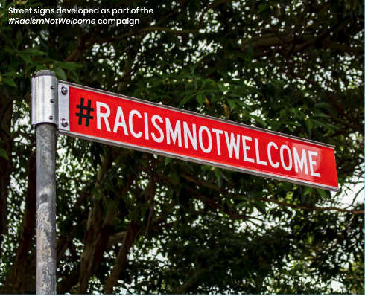
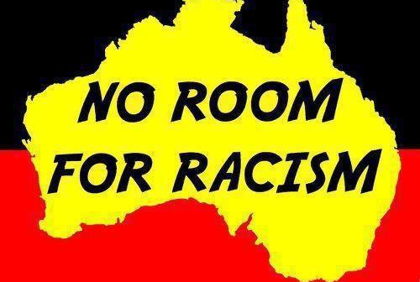

Z
Self-determination, Autonomy, Resilience and Advocacy
Street Signs developed as part of #RacismNotWelcome campaign
Aboriginal & Torres Strait Islander peoples suffered injustice since European settlement, however, have demonstrated resilience and autonomy
For Council it is important to:
Recognise efforts of all residents within the LGA in expanding networks and advocating for building relationships with Aboriginal & Torres Strait Islander peoples, communities, services and corporations
Refine our practices and protocols for working with Aboriginal & Torres Strait Islander peoples
Promote leadership and participation of Aboriginal & Torres Strait Islander celebrations, programs and events
Increase employment with equal participation and retention of not only staff but also community groups and organisations
Human Rights Commission sticker 2014
IWC Policy Document

Slide 22
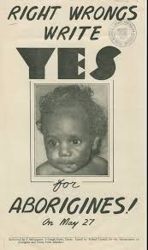
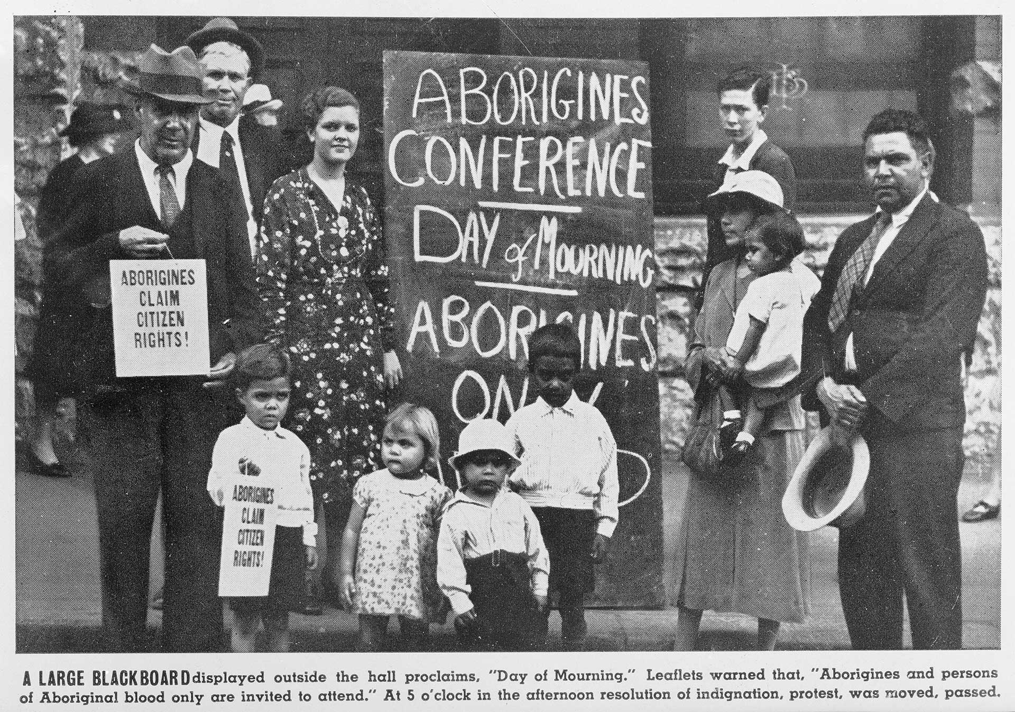
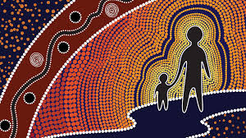
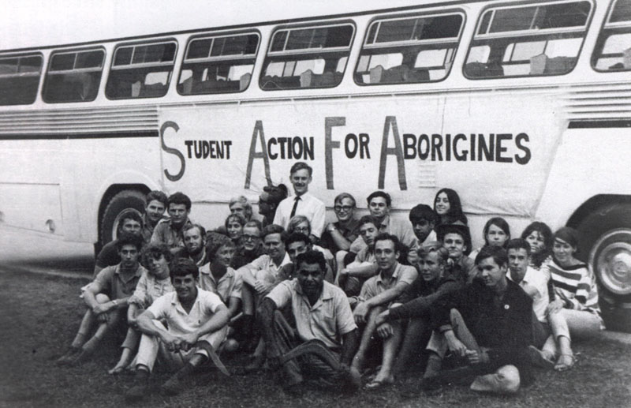
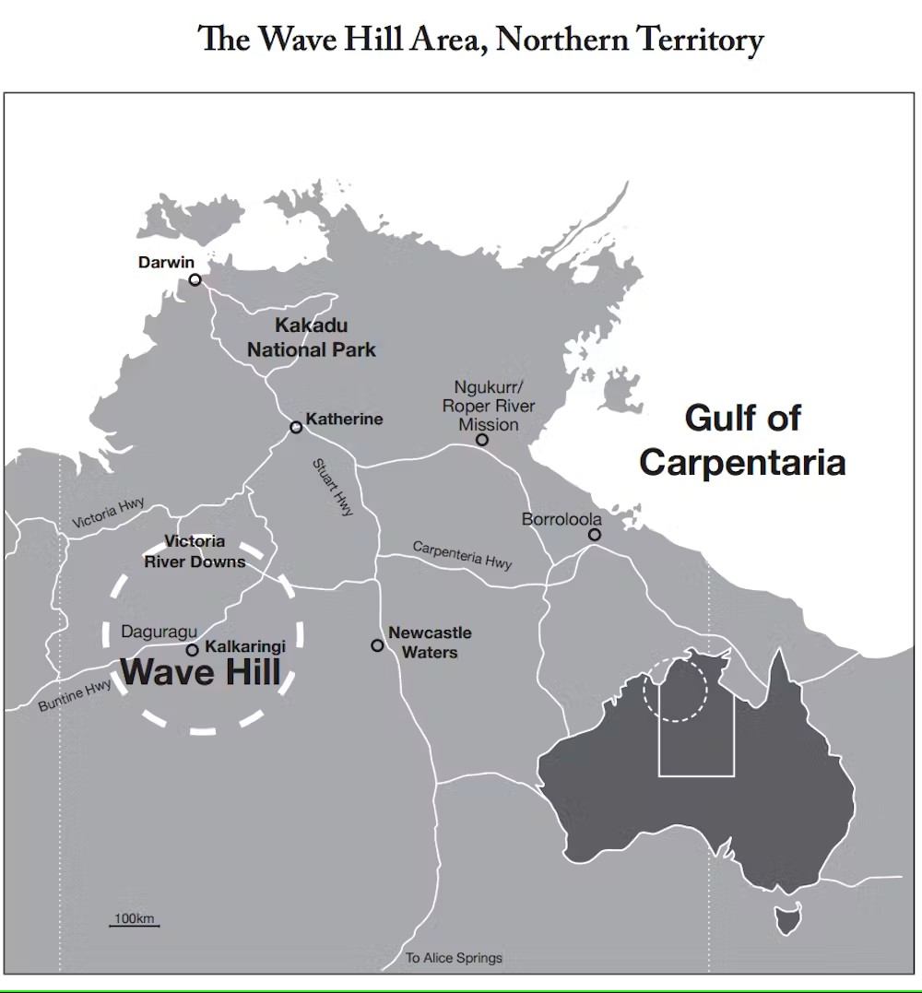

Z
Significant Dates for Aboriginal and Torres Strait Islander Peoples in your Local Area
1967 Referendum (27th May)
www.aiatsis.gov.au
1992 Mabo Decision (3rd June)
1938 January 26 – Day of Mourning
For more information, please see Aboriginal Identities Site Study
1998 National Sorry Day (26th May) annually
www.aiatsis.gov.au
www.perth.anglican.org
1965 – Freedom Ride
2008 National Apology (13th February)
For more information on the following dates please view Self-Determination & Autonomy PowerPoint
1966 August – Wave Hill Walk Off (NT)
www.theconversation.com
Aboriginal & Torres Strait Islander Flags with warrior figure outline in center – designed by Deborah Lennis 2013 for Leichhardt Council

