Slide 1


Aboriginal Identities – Site Study
Ng:tja AKA Douglas Grant

Slide 2

Protocols
Protocols for collaborating with Aboriginal and Torres Strait Islander Communities and engaging with Cultural works
NESA is committed to working in partnership with Aboriginal Communities and supporting teachers, schools and schooling sectors to improve educational outcomes for young people.
It is important to respect appropriate ways of interacting with Aboriginal Communities and Cultural material when teachers plan, program and implement learning experiences that focus on Aboriginal and Torres Strait Islander Priorities.
Indigenous Cultural and Intellectual Property (ICIP) protocols need to be followed. Aboriginal and Torres Strait Islander Peoples’ ICIP protocols include Cultural Knowledges, Cultural Expression and Cultural Property and documentation of Aboriginal and Torres Strait Islander Peoples’ Identities and lived experiences. It is important to recognise the diversity and complexity of different Cultural groups in NSW, as protocols may differ between local Aboriginal Communities.
Teachers should work in partnership with Elders, parents, Community members, Cultural Knowledge Holders, or a local, regional or state Aboriginal Education Consultative Group. It is important to respect Elders and the roles of men and women. Local Aboriginal Peoples should be invited to share their Cultural Knowledges with students and staff when engaging with Aboriginal histories and Cultural Practices.
This information needs to be read and understood before proceeding
https://curriculum.nsw.edu.au

Slide 3
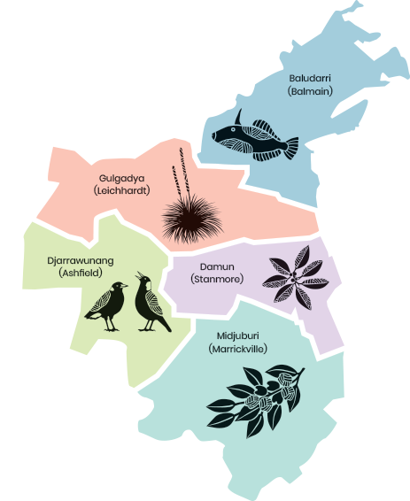
Disclaimer
Aboriginal and Torres Strait Islander peoples are advised this PowerPoint may contain names, works and images of Aboriginal and Torres Strait Islander peoples who are deceased.

Slide 4
Aboriginal Identities – Site Study
Ng:tja AKA Douglas Grant

Slide 5
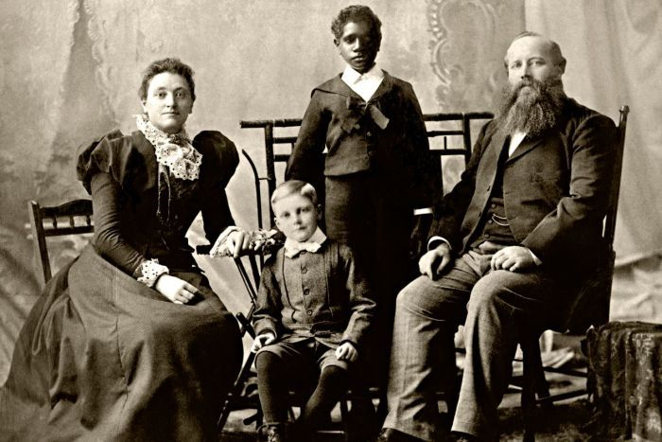
Formative years
Born as Ng:tja Bellenden Ranges North Queensland
Adopted by Robert and Elizabeth Grant
Lived in Albion Street Annandale NSW
Schooled at Annandale Public & Scots College, Bellevue Hill
1897 – 1st Prize Queens Jubilee Art
Grant Family Portrait C1896
L-R (Sitting) Margaret, Henry, Robert (Standing) Douglas
National Archives of Australia, Canberra SP1011/1-2176

Slide 6
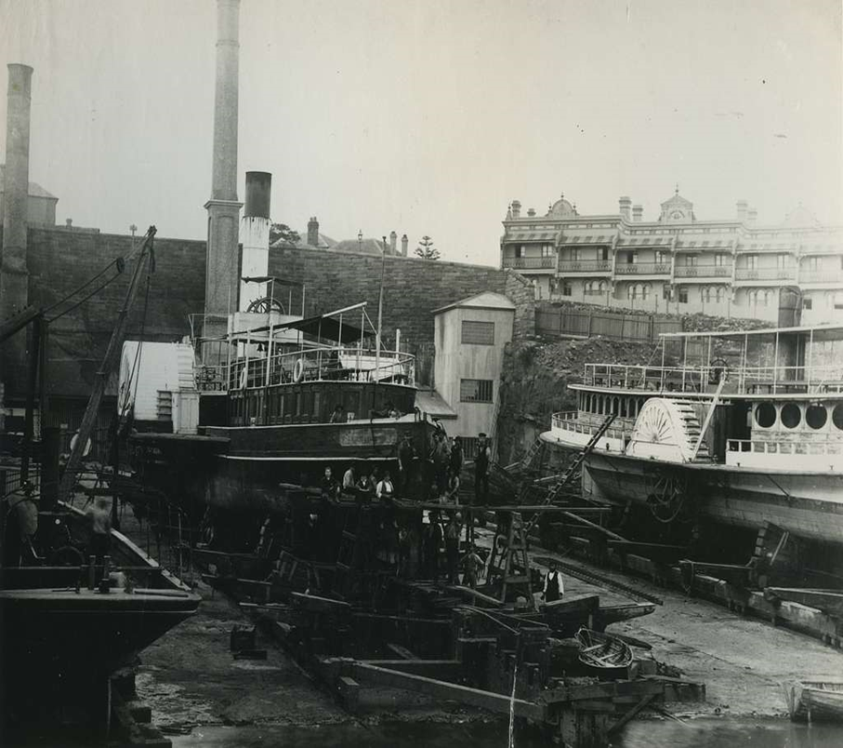
Morts Dock – Balmain
Loved Shakespeare and poetry
Passion in drawing
1st Job – Morts Dock
Trained as a mechanical draftsmen
Worked at the docks for 10 years
Sydney Ferries – ‘Brightside & Mille’ at Morts Dock C1900 https://jenikirbyhistory.get.achieve.net/media/Sydney-ferries-Brightside-and-mille-at-morts-dock-c1900-lae264

Slide 7
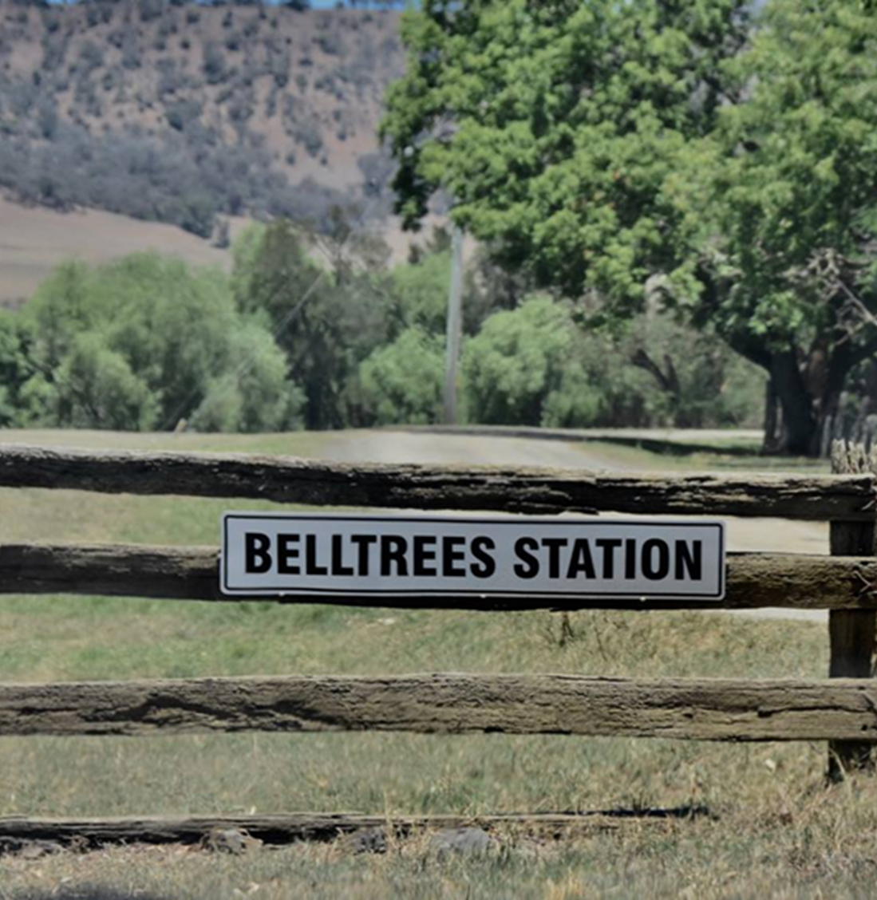
Before Enlistment in
World War 1
Belltrees Station Upper Hunter Valley (near Scone NSW)
Home of the White Family since 1831
Wool Classer at the Station
100 peoples working
180,000 sheep shorn annually
3,000 bales of wool sent to England until mid 1920’s
1912 BellTrees was a self-contained community
Public School
Community Hall
Post Office
Front Gate of Bell Trees Station www.facebook.com

Slide 8
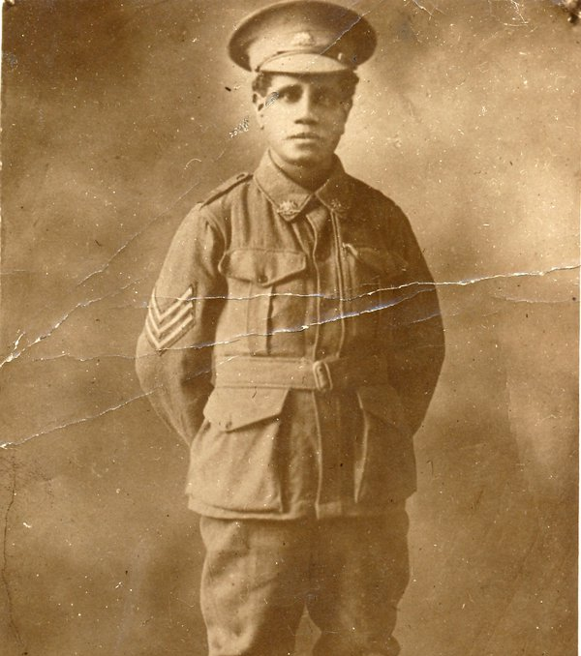
World War 1, 1914 -1918
Enlisted January 1916
34th Battalion
Sergeant
Could not leave Australia
(as a non-citizen); had to have government approval
Left November 1916
13th Battalion
Private
Sergeant Grant D – Australian War Memorial https://www.awm.gov.au

Slide 9
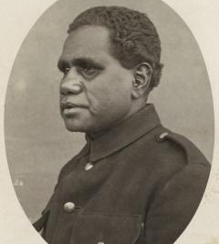
Prisoner of War
11th April 1917 wounded and captured
Used as forced labour for the German Army
Wunsdorf Camp in Zossen
Half science and half propaganda Camp
Distributed Red Cross parcels to prisoners within the camp
Jewish sculptor Rudolf Markoeser modelled a ‘bust’ of Douglas from Ebony
Douglas Grant – prisoner of War
Australian War Memorial https://www.awm.gov.au

Slide 10
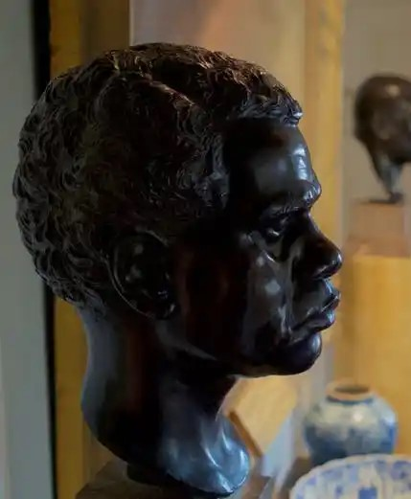
Douglas Grant Bust Found
Tantalising details of bust were on Public record
No-one knew where the Bust was or even if really existed
Years of searching all over Europe
Found June 2019 in Wiltshire, England
Owner – Rupert O’Flynn; it is on a plinth in his living room
It is cast in bronze and not carved out of either ebony or marble
Bust - Douglas Grant; image by Tom Murray 2019 https://www.australiangeographic.com.au

Slide 11
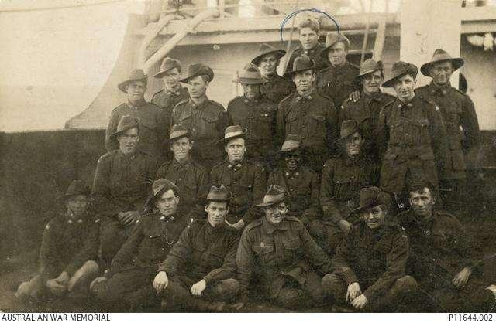

Returning Home
Went to Scotland to meet the adoptive family before returning
Returned to Morts Dock for a short period
Went to Lithgow to visit adopted grandparents
Douglas Grant (circled in red) and a group of Australian soldiers returning after WW1 – Australian War Memorial

Slide 12
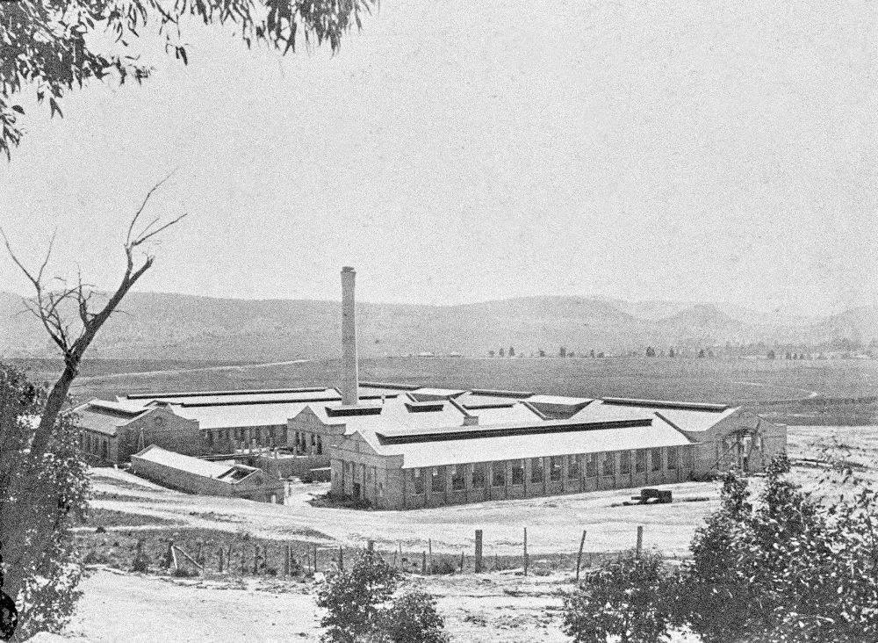
Paper and Small Arms Factory Lithgow
1912 Paper & Small Arms Factory in the snow – https://www.lithgow.com/historyavenue/photos/1912saf2.html
After World War 1 a decline in the workforce
300 men by mid 1922
2nd Job (3 years employment)
Returned Soldiers and Sailors Imperial League (now the Returned Services League - RSL)
Douglas was Secretary and fought for Social Justice Issues for the Australian Aborigine

Slide 13
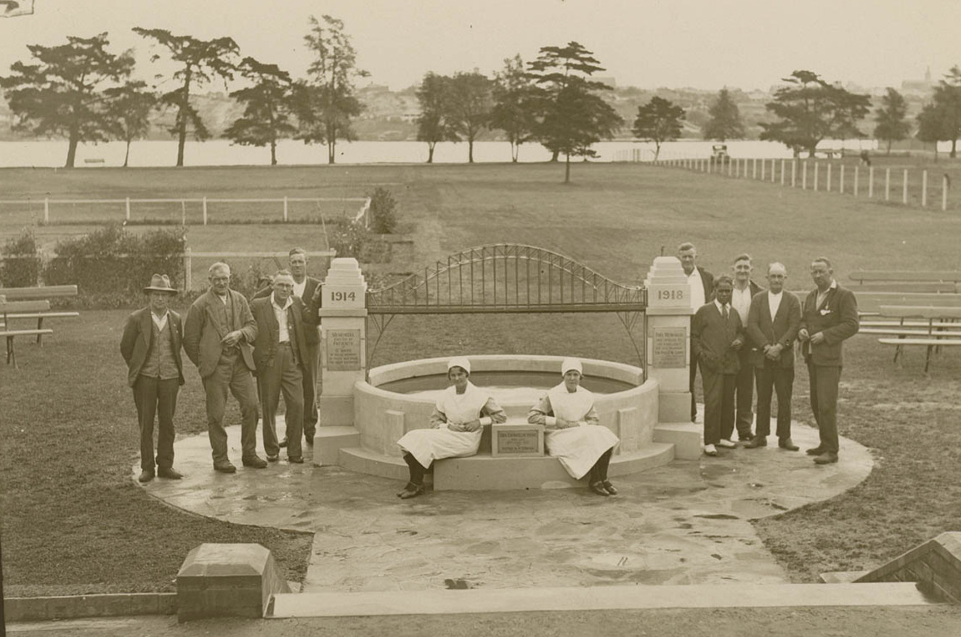
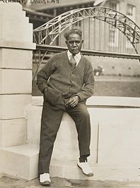
Callan Park – Rozelle NSW
Struggled with mental health issues
Worked as a clerk at ex-serviceman’s ward in Callan Park
Built the Sydney Harbour Bridge WW1 Commemorative Pond Memorial
Continued to fight for Social Justice for the Australian Aborigine
Above: 1931 Opening of the Sydney Harbour Bridge WW1 Commemorative Pond – by Douglas Grant in Callan Park. https://www.smh.com.au/entertainment/forgotten-in-the-line-of-fire-20131014-2vikn.html
Right: Douglas Grant -1931 - SMH

Slide 14
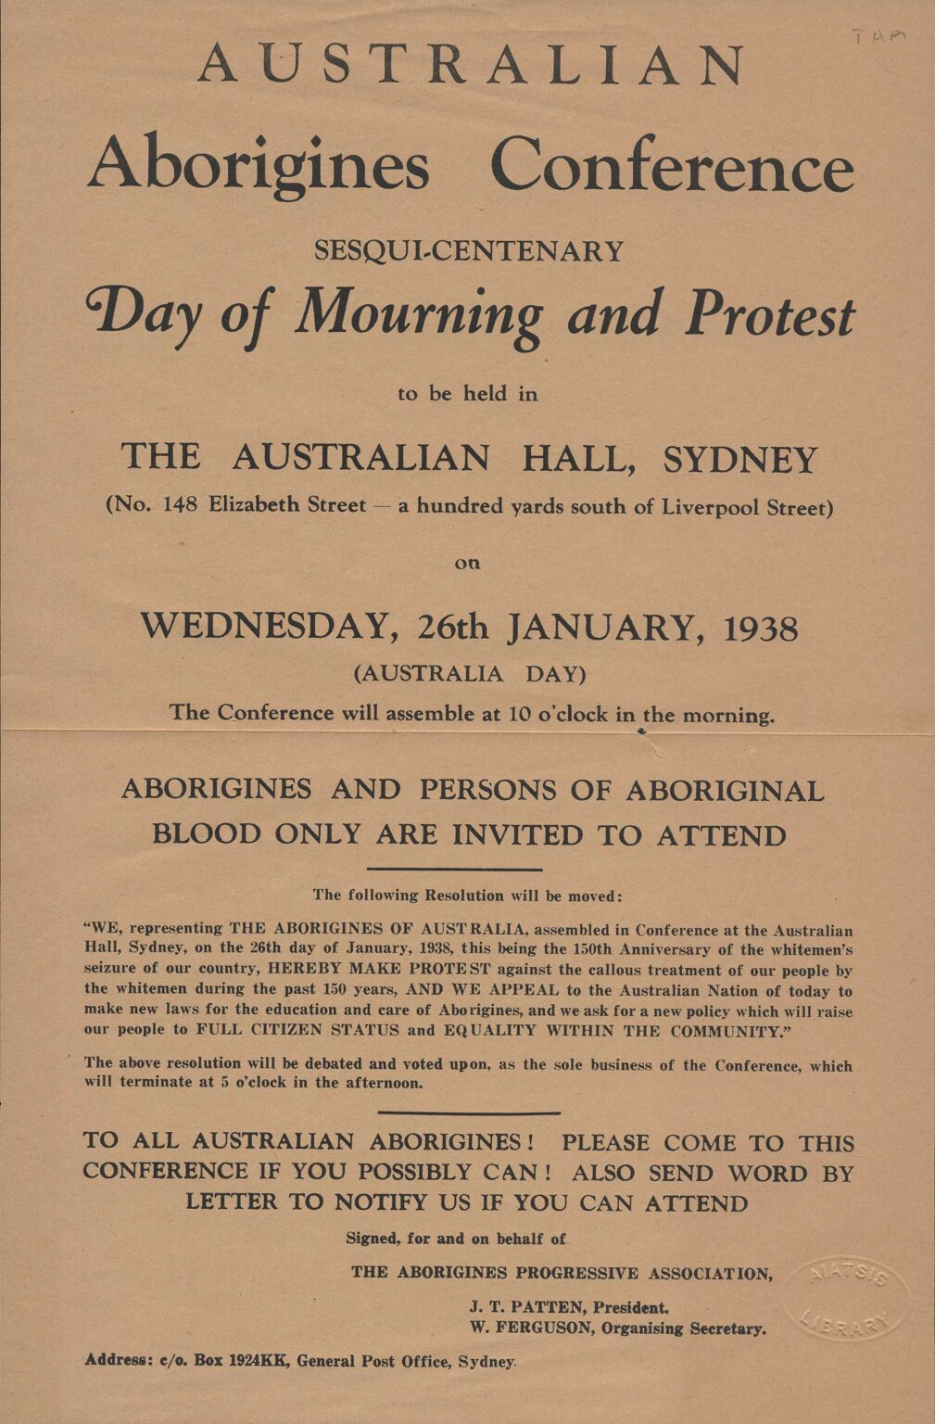
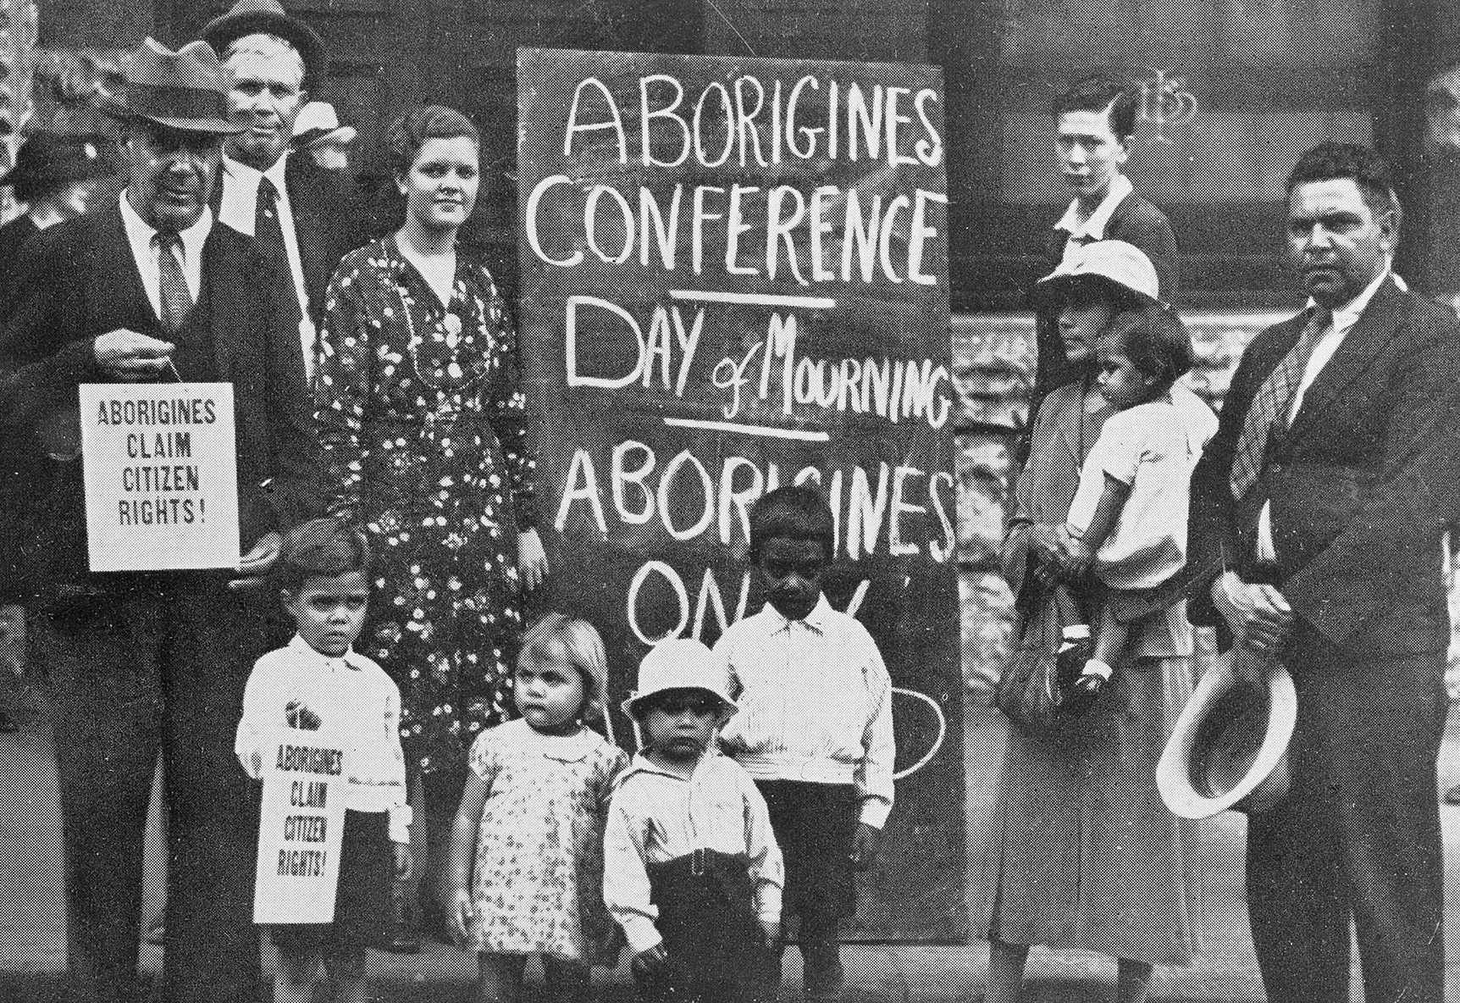
1938: Sesquicentenary and Aboriginal Day of Mourning
Bottom: 1938 First Day of Mourning – L-R: William Ferguson, Jack Kinchela, Isaac Ingram , Doris Williams, Easter Ingram, Arthur Williams, Phillip Ingram, Louise Agnes Ingram OAM holding daughter Olive Ingram, Jack Patton . AIATSIS Collection HornerL.J03BW https://www.
26th January 1938, 1st Aborigines Conference in Sydney
Organised by Aboriginal activists
Jack Patten
William Ferguson
William Cooper
Location – Australia Hall 150-152 Elizabeth Street Sydney
The Day of Mourning became an annual event for Aboriginal peoples
Moved over time to July and evolved into NAIDOC
Right: Invite to 1st Aboriginal Conference 1938 - https://www.nma.gov.au

Slide 15
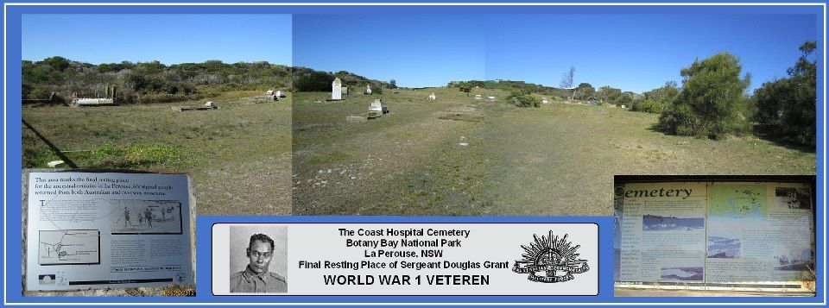
p
Final Resting Place
Died at Veteran’s Home – La Perouse NSW 1951
Local newspaper described him as
Brilliant scholar
Expert draughtsman
Ex-soldier
Smart dresser
Interesting conversationalist
Full blooded Aborigine
The cemetery in which Douglas Grant is buried - Source (unknown)

Slide 16
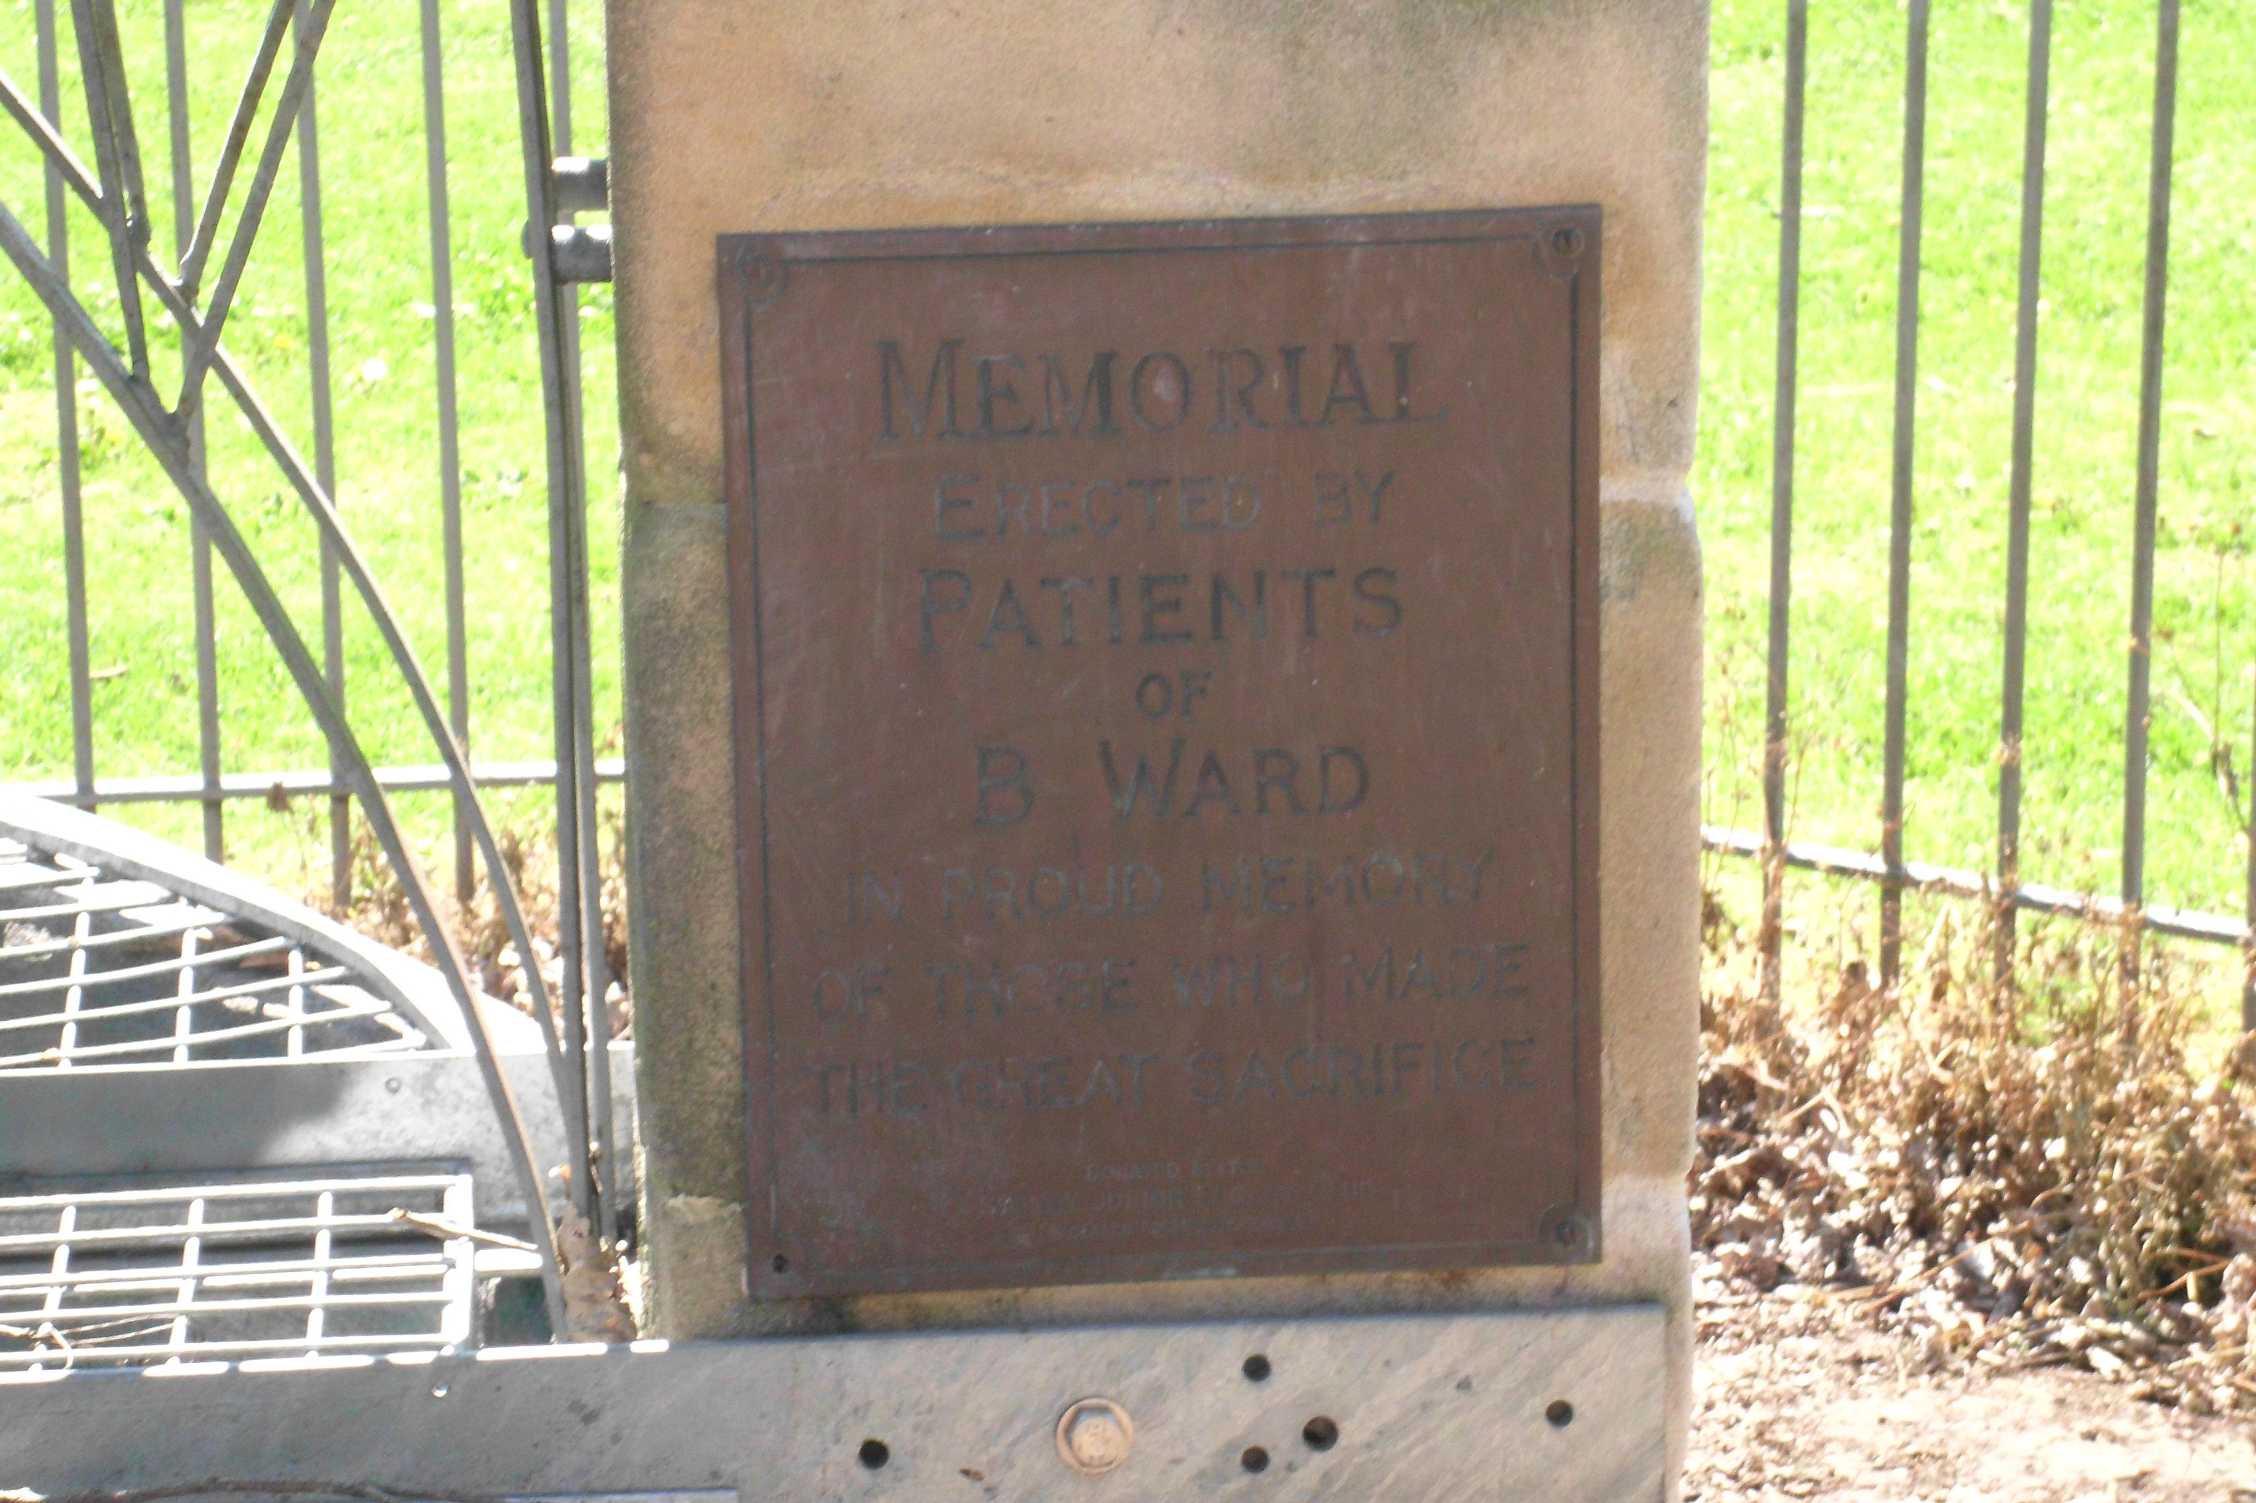
Legacy
Plaque on the Sydney Harbour Bridge WW1 Commemorative Pond Memorial – Callan Park (photo taken by Deborah Lennis on site 2020

Slide 17
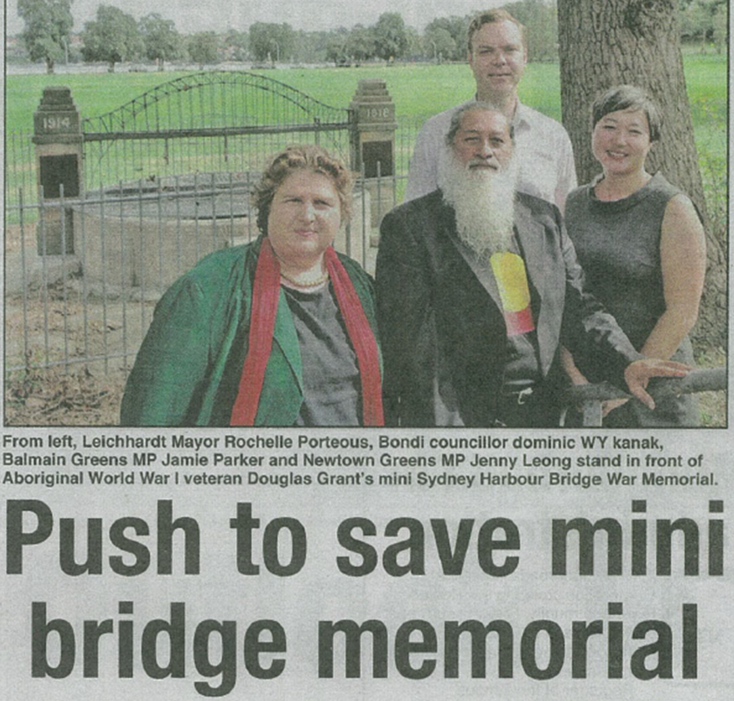
Newspaper Article – 2015
Former Leichhardt Council Mayor Rochelle Porteous
Searched for funding to fix the memorial
Koori Mail Article August 2015 page 12

Slide 18
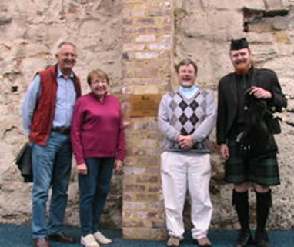
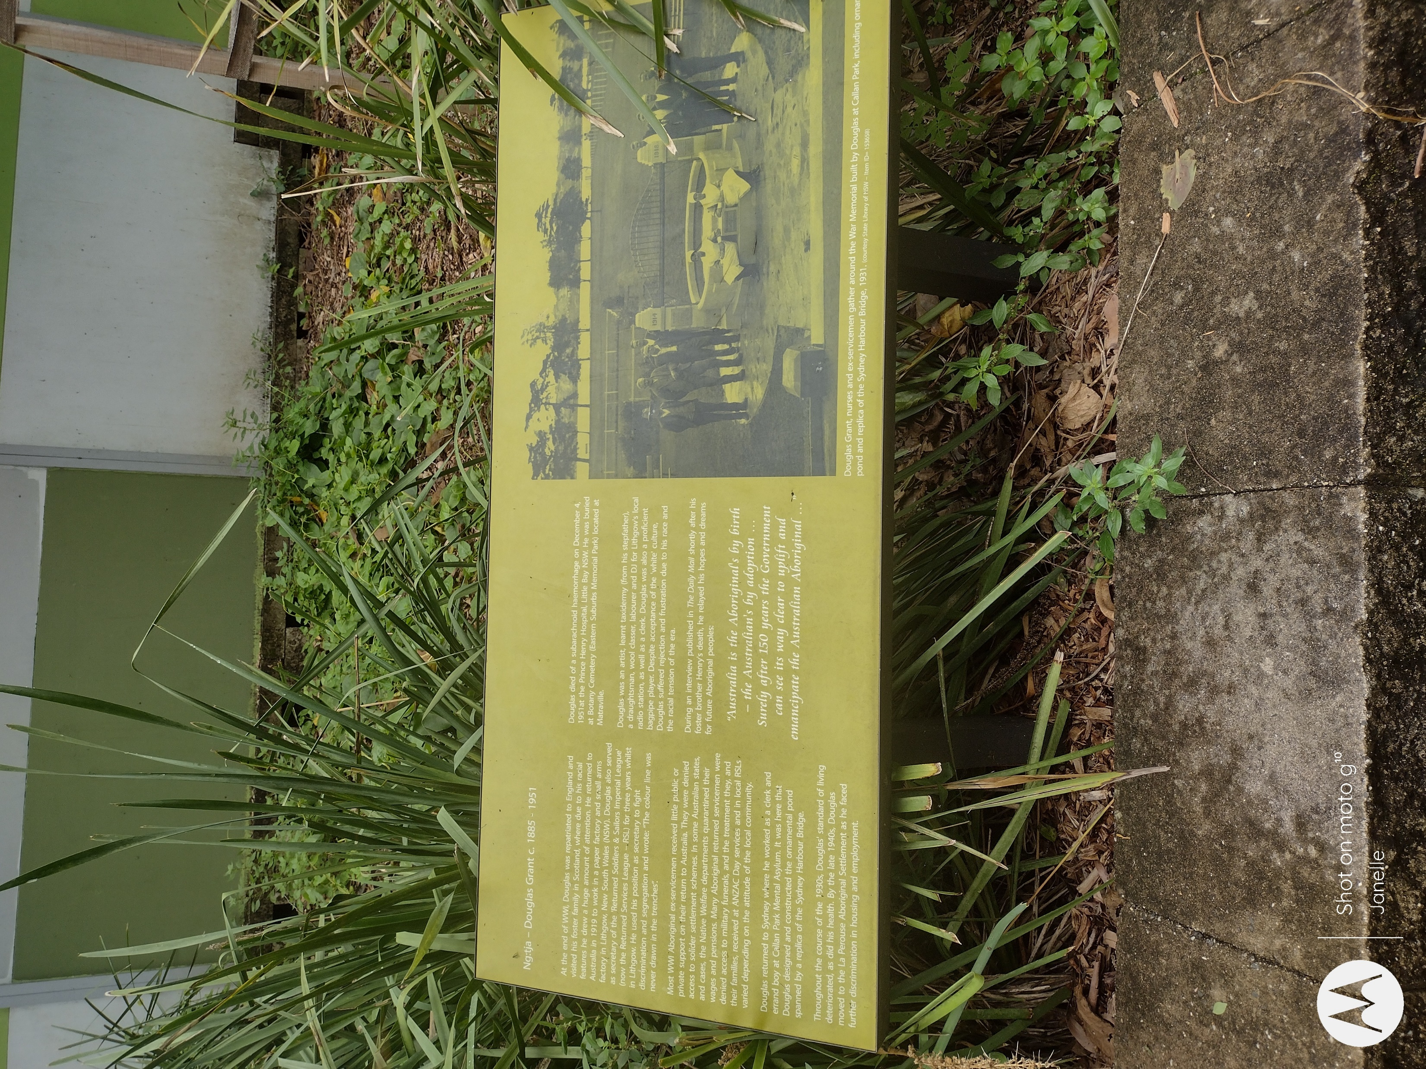
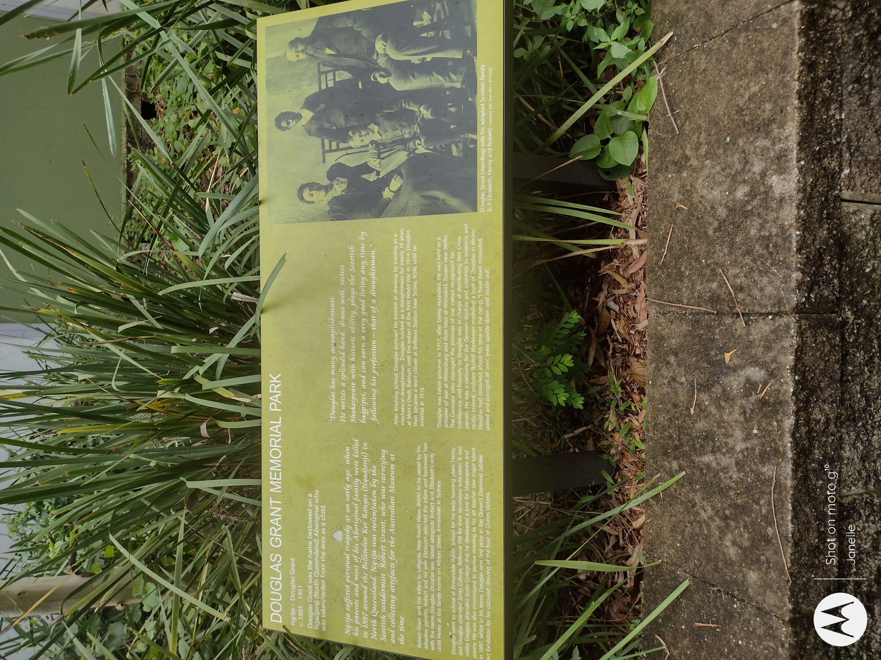
Douglas Grant Memorial Park Opening 2015
Opened with a Traditional Smoking Ceremony
Had the strains of the Scottish bagpipes in the background
Adopted family (relatives) invited
Signage went into the park in 2019
Signage at the Douglas Grant Memorial Park Taylor St Annandale - photo taken by Janelle Scott 2025
Adopted relatives of Douglas Grant at the Opening of the Douglas Grant Memorial Park – Corner Chester & Taylor Streets Annandale – photo taken by Marghanita da Cruz 2015

Slide 19
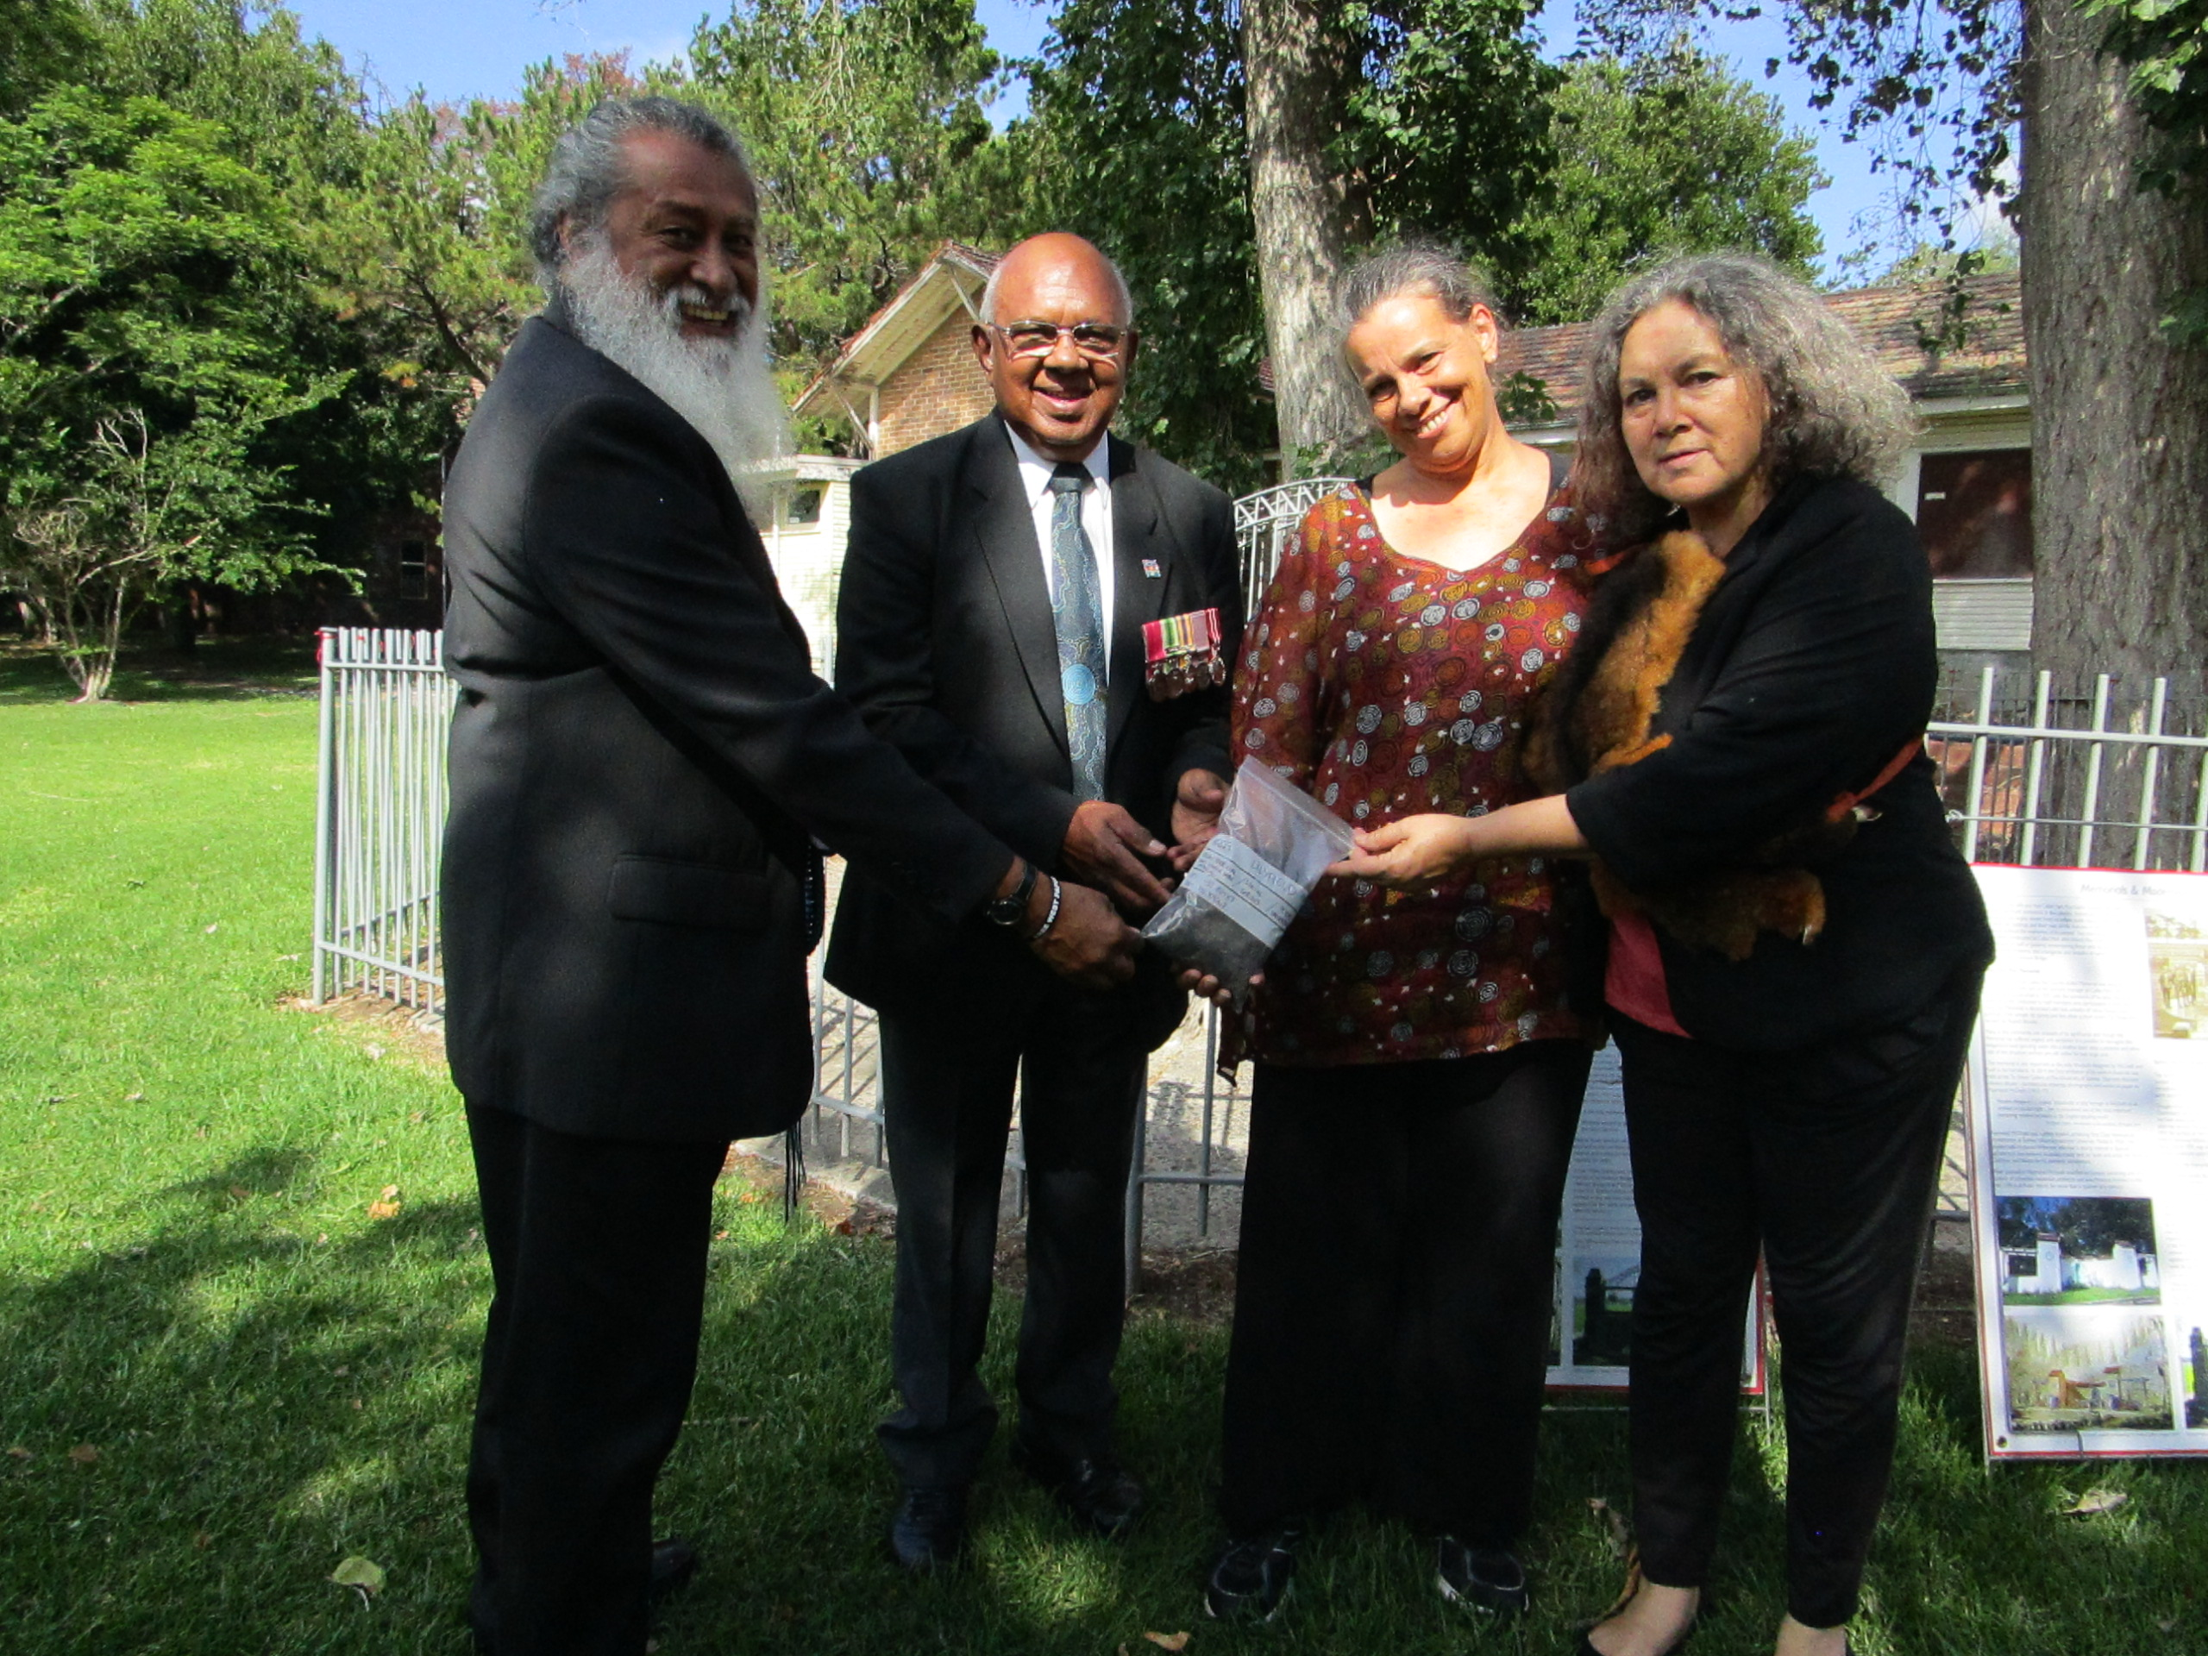
Collecting Soil – War Memorials NSW
NSW Veteran Affairs initiative
Artwork commissioned for the Hyde Park War Memorial – Sydney
Collected soil samples from War Memorials across NSW
Clr Dominic Wy-Kanak, Uncle Harry Allie, Aunty Deborah Lennis, Aunty Rhonda Grosvenor with the soil that was collected at the Sydney Harbour Bridge WW1 Commemorative Pond Memorial Callan Park 2016 - Photo taken by unknown

Slide 20
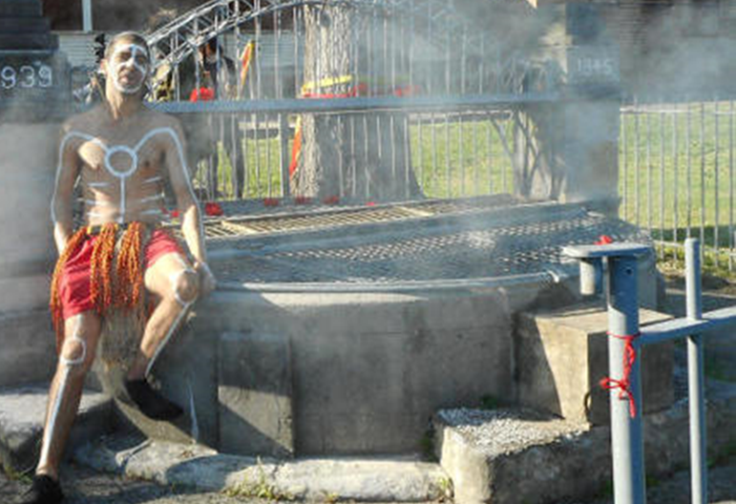
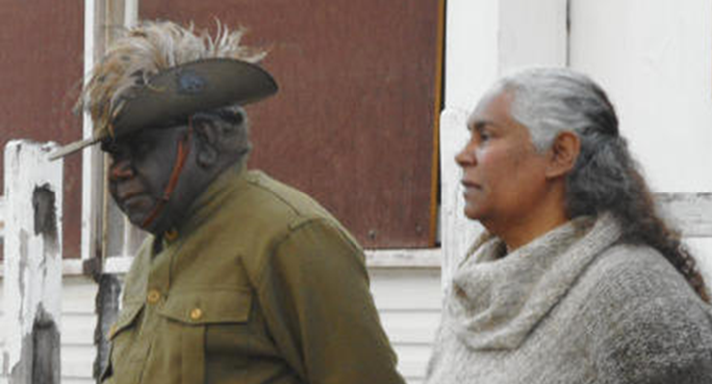
Remembrance Day - 2018
Traditional Smoking Ceremony
Wreath laid on Memorial
Poppies were also worn and laid on and over the Sydney Harbour Bridge WW1 Memorial
Ng:tja relatives at a Remembrance Day Ceremony 2018 at Callan Park – Photo taken by Marghanita da Cruz 2018
Traditional Smoking Ceremony on and around the Sydney Harbour Bridge WW1 Commemorative Pond Memorial – Callan Park

Slide 21
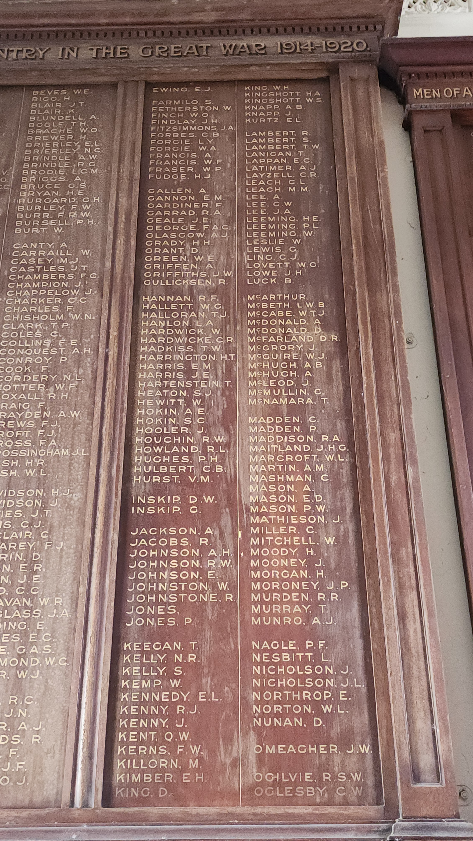
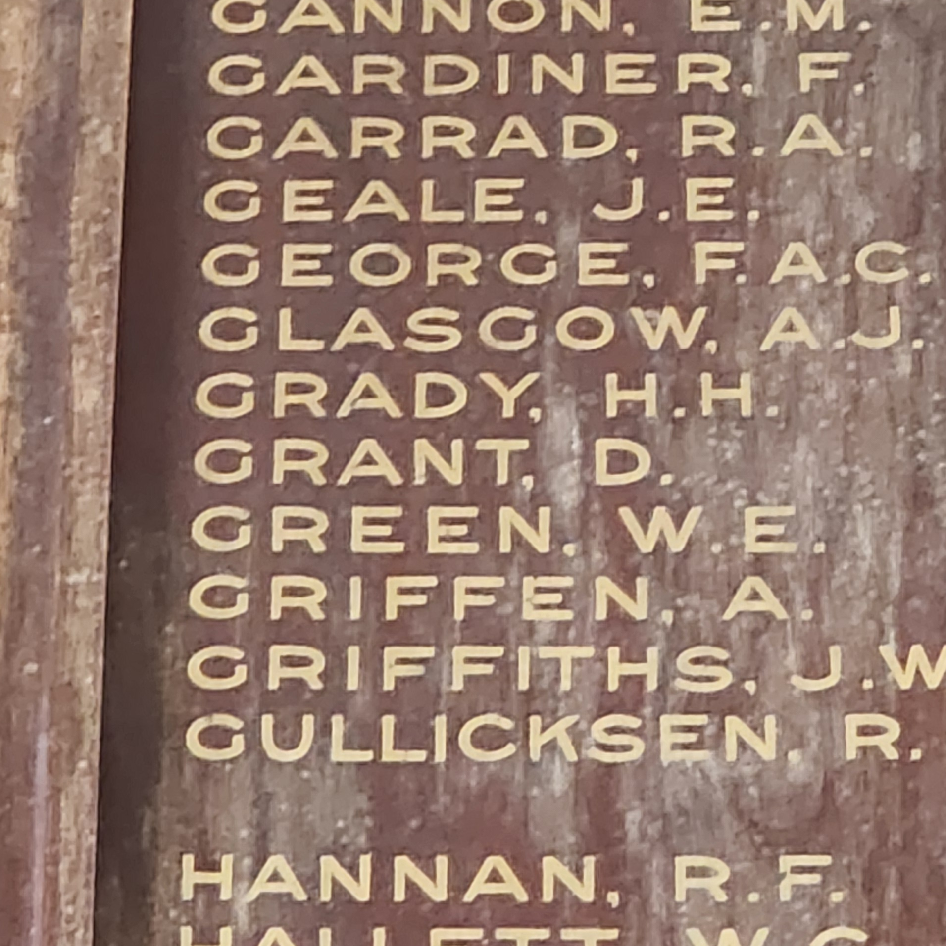

Honour Boards
Annandale Neighbourhood Centre
Annandale Public School
Hunter Baillie Memorial Presbyterian Church
Scone NSW
Honor Board at Annandale Neighbourhood Centre – Johnstone Street
photo taken by Ilce Kostrevski 2025

