Slide 1
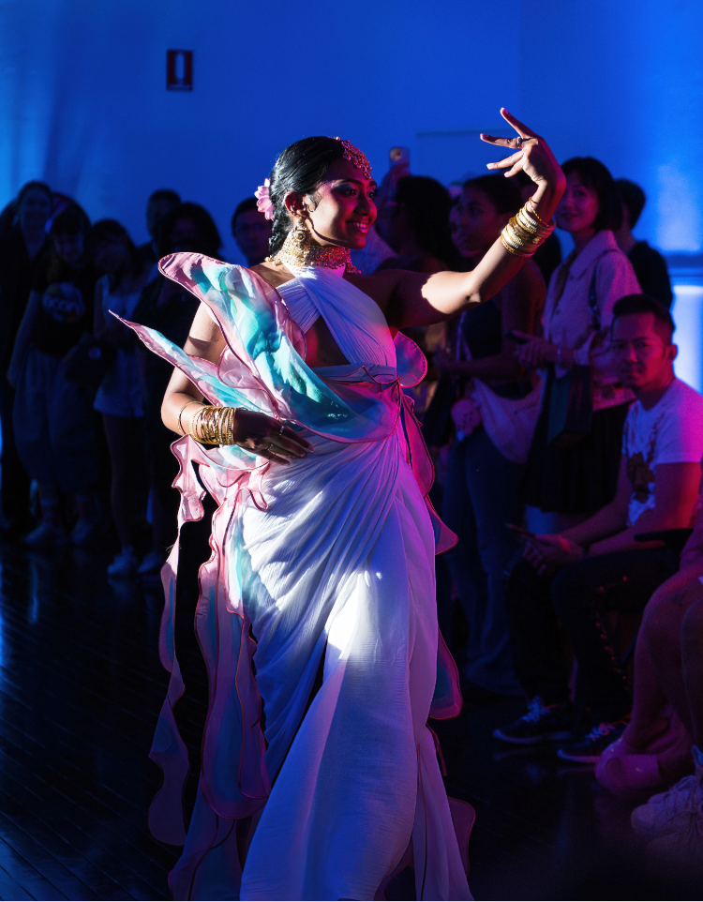
Cultural Connections 2025/26
Worship B’Day, Worship Queer Collective, photo by Rhiannon Hopley
Notes:
I would like to acknowledge the traditional custodians of the land on which we meet today, the Gadigal-Wangal clans of the Sydney basin and pay my respect to Elders past and present and extend my deepest respect to any Aboriginal people here today.
Acknowledge the role the arts play in preserving, honouring and expanding Aboriginal culture.
I would like to pay homage to our First Nations people across Australia for the care of country and celebrate the oldest continuing culture on earth and the birthplace of arts and culture in Australia.
This land always was, and always will be, Aboriginal Land.
The arts are one of the best tools for expression, compassion, learning and bringing people together.
Photos throughout this presentation have been provided courtesy of past Cultural Connections grant recipients.
Name, title, pronouns, toilets, emergency
Q&A at end but burning question please ask.
15 min pres followed by past grant recipient project overview – Dyan Tai.

Slide 2
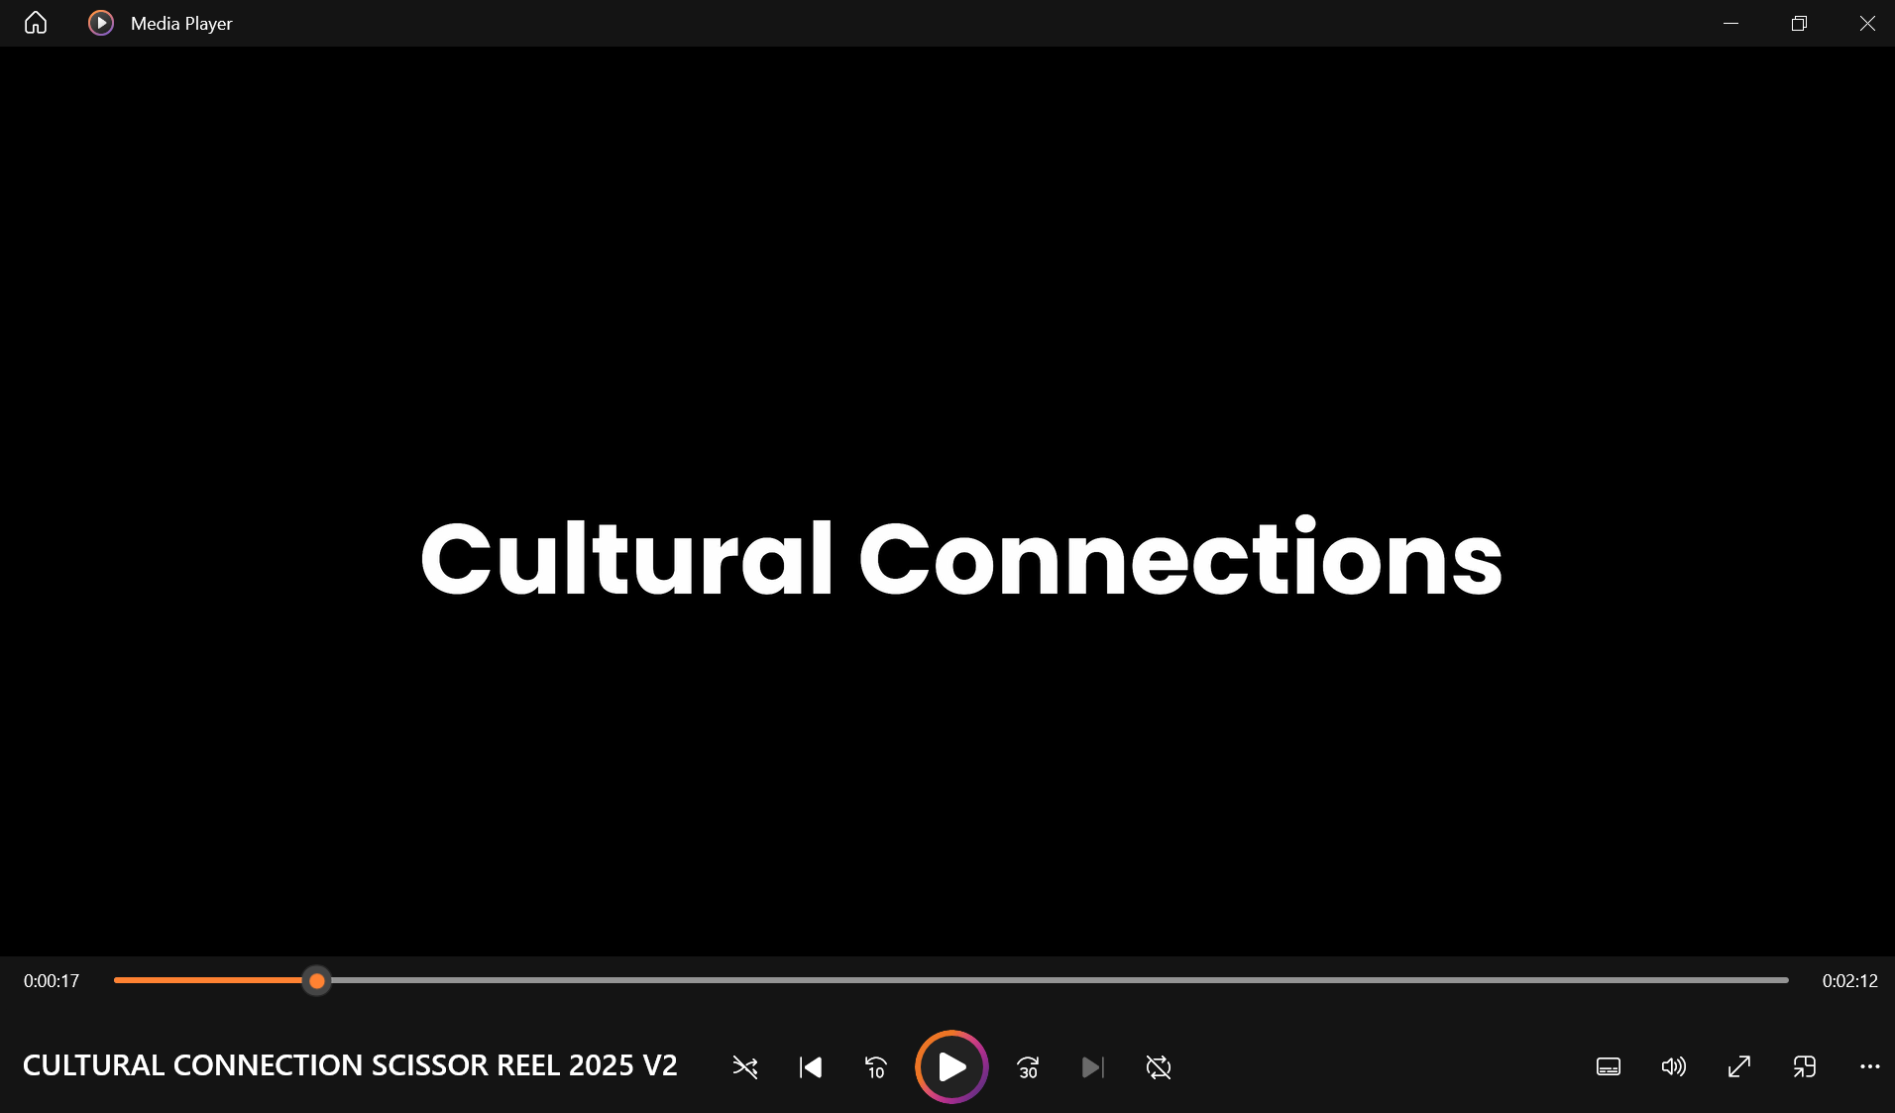
Cultural Connections 2024/5
Scissor Reel – Cultural Connections – draft clip by Sam Phibbs
Notes:
Here is a quick look at most of last years program to give you a glance and what projects were funded.
Please note Council isn’t just after events, you may propose workshops, audio recordings or literary works.
Anything really that is in line with the criteria and has some kind of creative outcome. An outcome does not need to be a finished work – it could be a showing of works in development.

Slide 3
enquiries & support
Enquiries: 02 9335 2293 (Mon-Thu)
If you need support, including access adjustments, please reach out.
If you’re d/Deaf or find it hard to communicate by phone, contact AccessHub / National Relay Service www.accesshub.gov.au / 1300 555 727
Free Interpreter: 131 450 (ask them to call Council 02 9392 5000)
Notes:
We encourage applications from a range of people showcasing our whole community. If there is something we can do to support you applying or with your proposal, reach out early so we can make accessibility adjustments.
For general Cultural Connections enquires you can me between 8.30am and 4pm (Monday - Thursday) on the numbers listed in the slide.
Cultural Connections is more than a grants program. It is a program designed to support artists in delivering their own work.
Successful applicants will be provided with tailored support, which may include:
• project planning
• navigating ticketing processes
• drafting risk plans
• marketing plans
• printing
• event support
• navigating Council processes
• rehearsal space/venue scouting
• proof reading
Applicants will be checked in with in the lead up to their project to see how they are going and what support they might find useful.

Slide 4
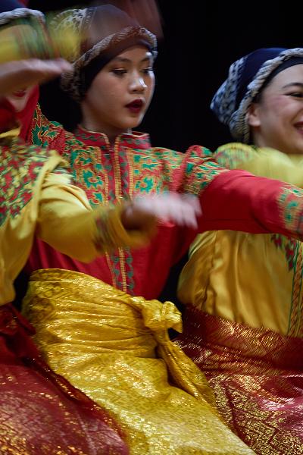
objectives
diverse representation in the arts
cross cultural understanding
arts participation for children and young people with a cultural perspective
recognition of cultural diversity as an asset and contributor to innovative arts practice
sharing stories about our local area and who we are
Suara X Langen Suka, Suara Dance, photo by Shane Rozario
Notes:
This EOI is an opportunity for community to collaborate with Council and to access resources to encourage:
diverse representation in the arts
cross-cultural understanding
arts participation for children and young people with a cultural perspective
recognition of cultural diversity as an asset and contributor to innovative arts practice
sharing stories about our local area and who we are

Slide 5
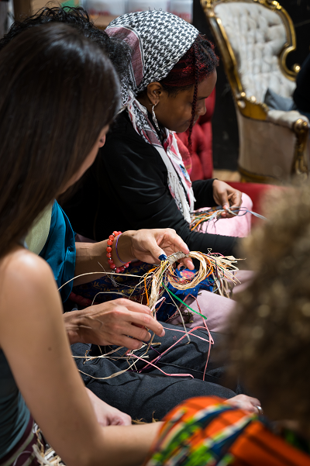
applications
up to $8,000
40K overall
Assessed by peers
Remembering our Roots, Nicole Barakat, photo by Rhiannon Hopley
Notes:
There is a total of $40,000 available - applicants can apply for up to $8,000 for proposed projects.
The EOI will be assessed by a panel of Aboriginal and Torres Strait Islander, CALD, PoC stakeholders from within the industry and Council staff – encouraging participation in democracy and decision making at a local government level.

Slide 6
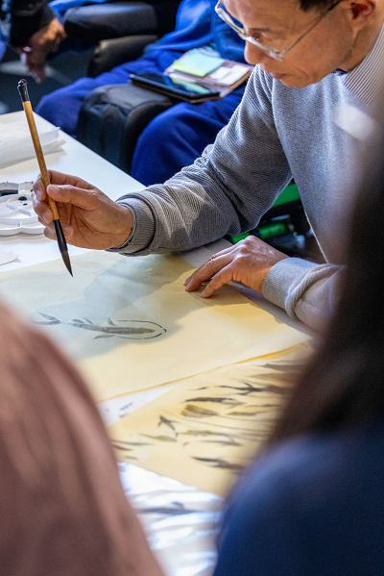
eligibility
Reside in Inner West or project in IW
Projects need a creative outcome
Australian residents aged 18+
Unincorporated groups or non Aus residents can be auspiced by a NFP
Legally registered, incorporated NFP orgs
WWCC
Online via smartygrants
1 application per person/ group
If successful required to enter contract with Council
PLI 20mil
Consideration of return applicants
Artist workshop with Dr Fan Dongwang,
photo by Milk & Honey Photography
Notes:
Who can apply?
Applicants must reside in the Inner West or be undertaking projects that benefit the Inner West community
Applicants do not need to identify as a creative, but projects must have a creative outcome
Australian residents or permanent residents aged 18+
Unincorporated groups or non-Australian residents must be auspiced by an incorporated not-for-profit (NFP) organisation
Legally registered, incorporated NFP organisations or groups
If working with children a valid Working with Children Check must be provided
All applications must be submitted online through smartygrants
Only one application per person/group is permitted
Successful applicants will be required to enter a contract with Council and supply relevant insurances (Public Liability Insurance $20mil)
The panel will consider the spread of new and returning artists to the program each year.

Slide 7
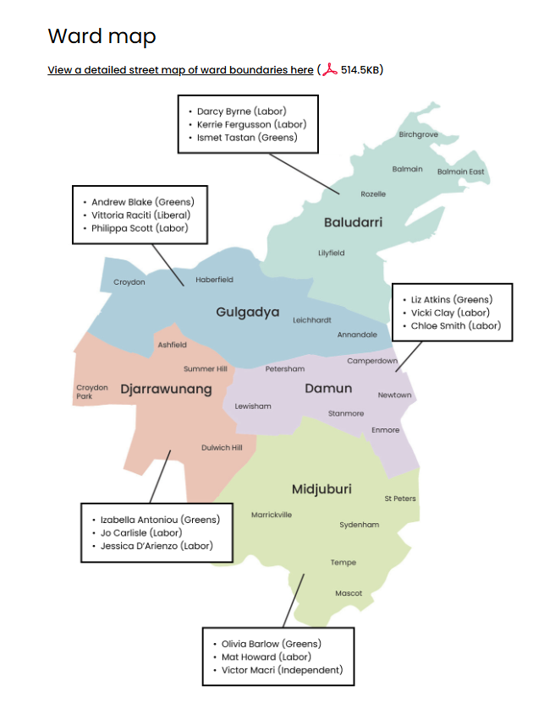
suburbs in the
Inner West
Check location of your project here:
https://www.olg.nsw.gov.au/public/find-my-council/
Notes:
It is important to make sure you are proposing projects that are based in the Inner West you can use this website link to check you re within the IW boundary.

Slide 8
assessment criteria
Skills and experience to deliver the project (20%)
Project meets two or more of the EOI aims (30%)
Benefits of the project to community (30%)
How practical and achievable the project is within the proposed budget (20%)
Notes:
These are the questions you will be asked in the application form, so prepare your answers to directly address each criteria. This is how the assessors will judge the application.
The individual or team’s skills and experience to deliver the project (20%)
Does the applicant show that they have the skills and experience to do what they say they will?
Is there evidence of this in their supporting material? E.g. photo of similar work, if running a workshop do they talk about their facilitation skills?
Is the project viable – if partners are mentioned are they confirmed?
Are there any qualifications or experiences shared that are relevant to the project?
Are there samples of previous work that demonstrate the applicants quality of work?
2. How well your project meets two or more of the EOI aims (30%)
diverse representation in the arts (how many artists from diverse backgrounds? Will your project showcase diversity)
cross-cultural understanding (are there moments for people to learn a new skill, understand history/culture, showcase cultural experiences?)
arts participation for children and young people with a cultural perspective (are you working with children, is there an opportunity for them to experience culture?)
recognition of cultural diversity as an asset and contributor to innovative arts practice (are you demonstrating excellence in what you are doing, what will the impact be on the arts, marketing ideas to showcase your wok and platform it)
sharing stories about our local area and who we are (are you contributing to the stories of the Inner West, helping us explore and discover who lives here – culture isn’t static – it is always changing we want to showcase this)
3. The benefits of the project to community (30%)
How will the project impact or benefit the IW community?
Can you discuss how the project will positively impact the IW community? Is there an identified need for the project (research, statistics, findings) Letter of Support from partners or industry/artists/community showcasing need for the work?
4. How practical and achievable the project is within the proposed budget (20%).
(this includes clear documentation of what you intend to spend the money on with quotes for any items over $500) Does the budget add up?
If tickets are being charged is there a projected income from this – is it clear what this income will be spent on (e.g. artist fees, materials etc).
Are there low-cost tickets/ concessions? Are quotes provided for materials/services over $500?
Are wages based on NAVA, MEAA, ASA or other peak industry boards? If Council fee waivers have been applied for and approved is the in-kind cost added to the budget or discounted fee?

Slide 9
timeline*
Date | Item
7 July 2025, 9am | Grant round opens
4 August 2025, 3pm | Grant round closes
August 2025 | Eligibility/Assessment -> Recommendations made to Management
August/ September 2025 | Applicants notified of outcome Agreements signed and returned with invoices
October 2025 – June 2026 | Projects delivered
June 2026 | Projects acquitted
June 2026 onwards | Projects documented on council website
Notes:
The Grant Round Opens – Monday 7 July, 9am – I advise you read the guidelines and look through the whole application.
Grants close Monday 4 August at 3pm – make sure you submit your application beforehand. To avoid technical difficulties, you should aim to finish at least an hour before the deadline so you have time to call smartygrants incase something isn’t working.
Eligibility & Assessment – during this time eligibility checks and assessment of your applications takes place . A panel made up of council staff and an external peers will meet to make recommendations on funding. Their recommendations need to go to Management for endorsement. Sometimes approvals are delayed.
Artists will be officially notified of their application outcome in August via writing, usually a smartygrants email – you can ask for feedback if you aren’t successful.
Successful applicants will be asked to sign agreements in August/September and provide official documentation like Public Liability Insurance – at this point you will be also asked to invoice Council for the grant money. And you will also be provided with IWC logos for your marketing.
Projects can be delivered between the time you receive your funds until June 2026 – all successful grant applicants are required to provide copies of their marketing materials acknowledging Councils support via “IWC Funded or Supported by logo placement”. No Marketing should be done until Council has approved the materials.
Finally, all grants need to be acquitted by 31 June 2026 unless you have confirmation in writing from the Grants Officer for an extension.

Slide 10
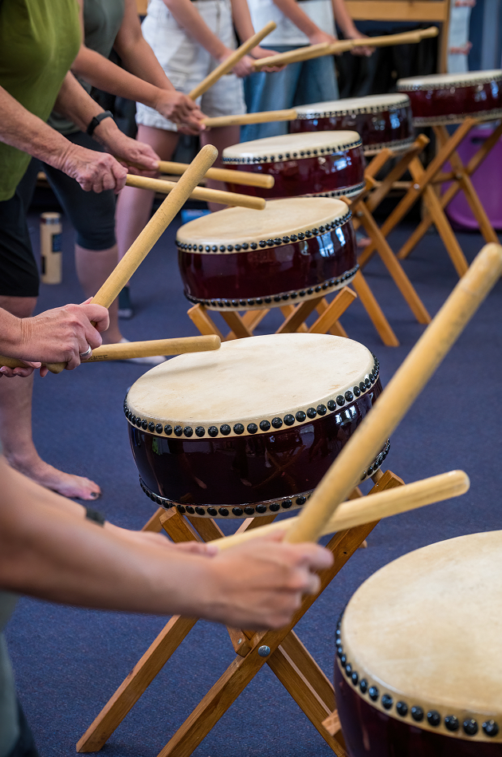
tips
Start early
Read the guidelines
Address the criteria
Budget realistically
Remember: no travel costs
Confirm any other funding sources
Provide supporting documentation
Check your application is submitted
YuNiOn Taiko Drumming workshops,
photo by Rhiannon Hopley
Notes:
Start an application straight away - see what is asked of you take notes on immediate things you need to do - you can go back in and edit your application until you press submit! Look into what supporting documentation you need – partners, venues, fee waivers, samples of work, resumes, quotes, NFP/Incorporated status (if applying as an org).
Read the guidelines carefully to ensure you meet the assessment and eligibility criteria. Make sure you address the criteria directly in the application. How does your project connect with the EOI objectives, can you provide evidence?
Review your application – ask someone who doesn’t know about the project to read the application – does it all make sense to them?
Submit a realistic budget. What costs are involved with each part of your project, PLI, admin, materials, wages, venue, photographer, graphic design, marketing. Review each part of your project and run through the costs involved for each, inc. admin.
Confirm status of any other funding sources. If you applying for more $$ from somewhere else, is it confirmed? If so, be sure to provide evidence of this (grant acceptance letter, letter from contributors). What is your back up plan if you do/don’t receive the funds? Explain this in the application.
Supply supporting documentation to demonstrate you have planned the project carefully and have the skills and qualifications to do what you say you will. This includes quotes, your CV or portfolio, letters of support from any partners or contributors. For projects that engage with community what is the engagement strategy, what is the experience, qualifications, skills of the facilitators?
Once you have submitted an application you will receive an email notification from smartygrants thanking you for your application – if you haven’t, your application hasn’t been submitted.

Slide 11
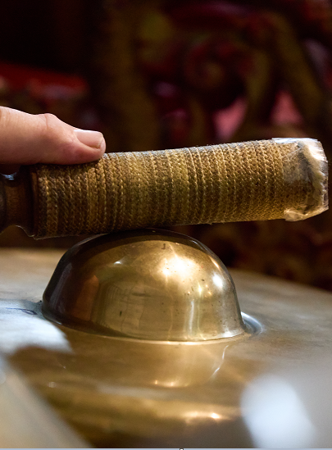
apply now!
Start an application now –
you can go back and edit /save as you go
https://innerwest.smartygrants.com.au/CulturalConnections20252026
Don’t forget to submit – 4 August at 3pm
Suara X Langen Suka, Suara Dance, photo by Shane Rozario
Notes:
The full guidelines are available on Council website / the arts grants page – there are some here today you can take home.

Slide 12
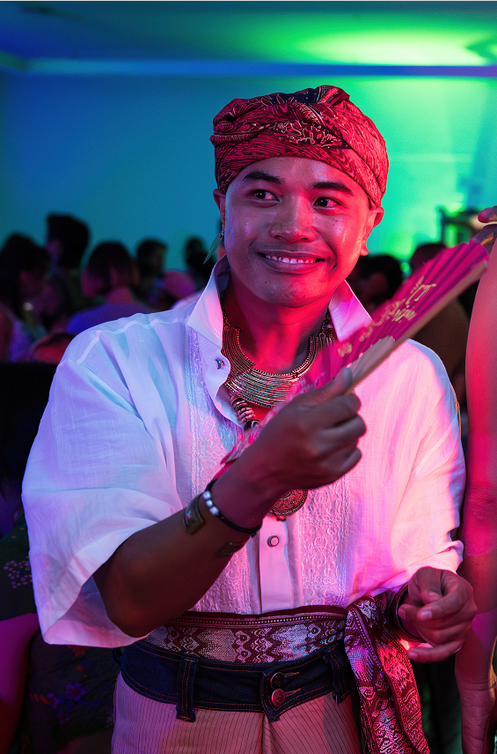
questions?
If you have questions you can reach out to Raffaela:
Enquiries: 02 9335 2293 (Mon-Thu)
Raffaela.Cavadini@innerwest.nsw.gov.au
Technical form problems:
Smartygrants 03 9320 6888
or email: service@smartygrants.com.au
Worship B’Day, Worship Queer Collective,
photo by Rhiannon Hopley
Notes:
If you have questions regarding your application you can reach out to: Me.
For technical problems with the form - Smartygrants email or phone number, quote them your application number.
If you wanted to ask a quick question feel free to ask me at the end of Dyan’s presentation.
Thank you for your time this afternoon and I wish you the best of luck with your applications.
I would like to introduce Dyan Tai, he/they.
Last year Dyan and Worship Queer Collective were part of the Cultural Connections Program.
They delivered an outstanding event “Worship B’day” celebrating queer Asian excellence in the arts at the Pride Centre. They will share more with you.
Self-described Gaysian Empress of Sydney, Dyan makes electronic hyperpop music fused with Beijing opera and traditional Southeast Asian soundscapes.
​​From humble beginnings in Malaysia to finding a niche on Sydney cabaret stages and now evolving into an electronic artist, the trilingual Chinese-Australian artist’s captivating live shows have been described as “a queer, euphoric dream that you don’t want to wake up from”.
Dyan is also a performance artist, and event producer, showcasing works at Art Gallery NSW, St Kilda Fest, Powerhouse Museum, Museum of Contemporary Art, Brisbane Powerhouse, BigSound, Sydney World Pride 2023, Vivid Sydney and Biennale Sydney 2024 (to name a few). Dyan is also the founder of Worship Queer Collective.
Dyan has an album launch in 2 weeks, for their new work, Supreme, 25 July at the Imperial Hotel. Highly recommend you check it out!
Please make welcome Dyan Tai who will share more about their project.

