Slide 1
Capital Works Projects Update

Slide 2
Agenda
Recently Completed Projects
Projects in Construction / Design / Scoping
PAMP Update
Projects for Discussion

Slide 3
Recently Completed Projects

Slide 4
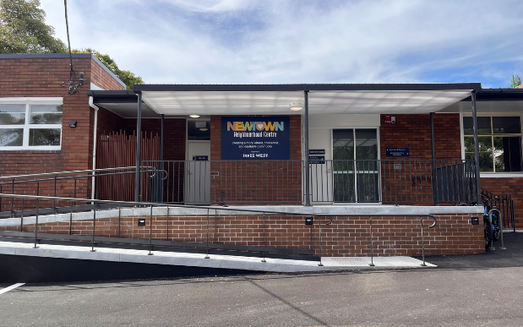
Tom Foster – Newtown Neighbourhood Centre
New access ramp and entry
New fully accessible toilet
Ambulant toilets

Slide 5
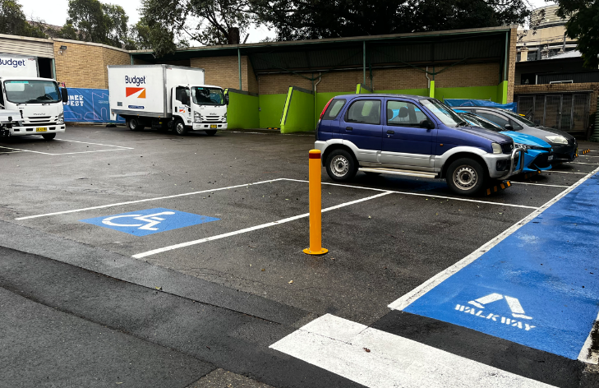
Summer Hill Sustainability Hub
New accessible toilet
Accessible parking spaces and paths of travel

Slide 6
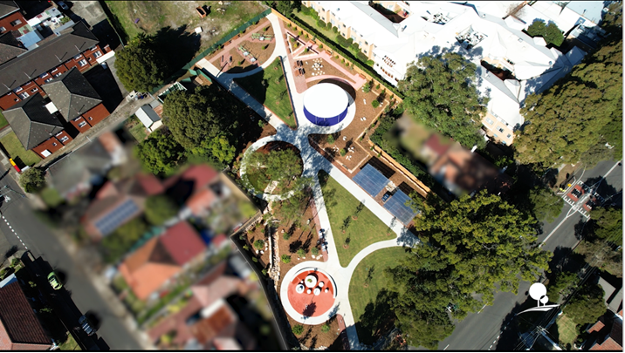
Lewis Herman Reserve
New accessible park including inclusive play spaces, nature play, park facilities, pathways and landscaping

Slide 7
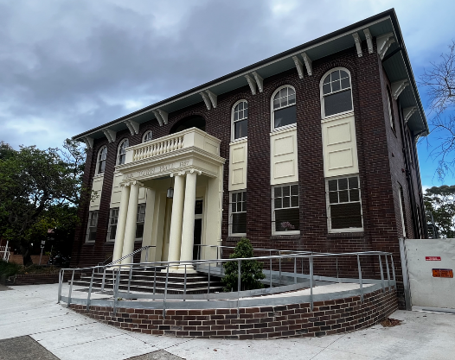
Marrickville and St Peters Town Halls
New main entry access ramp at St Peters Town Hall

Slide 8
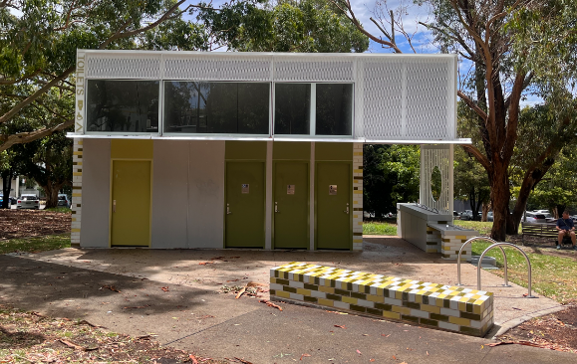
Camperdown Memorial Rest Park New Public Toilet
New fully accessible toilet
2x ambulant toilets

Slide 9
Projects In Construction, Design or Scoping

Slide 10
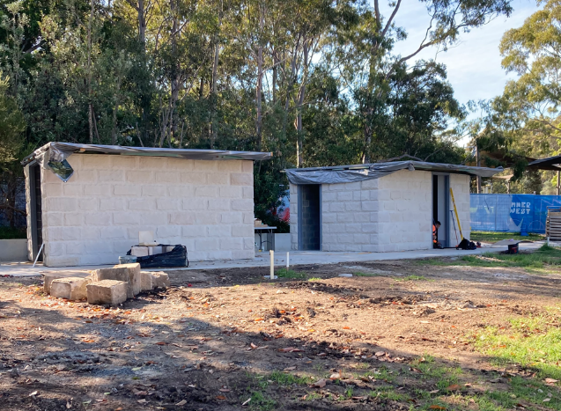
Pioneer Memorial Park New Toilet
In Construction
New accessible toilet
2x Ambulant Toilets

Slide 11
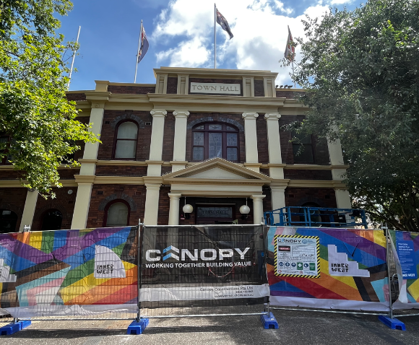
Newtown Town Hall / Pride Centre
In Construction
New adult change with accessible toilet
Accessibility improvements including Easy Step Lift

Slide 12
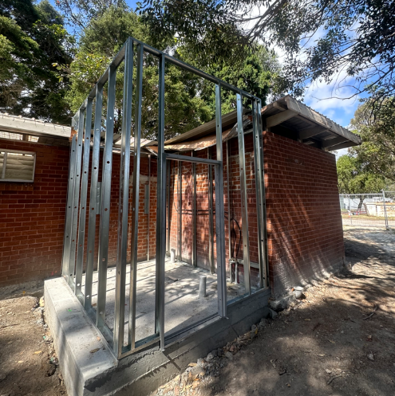
HJ Mahoney Memorial Reserve Amenities
In Construction
New fully accessible toilet
General accessibility improvements to provide access into changerooms and kiosk
Renewal of existing public toilets

Slide 13
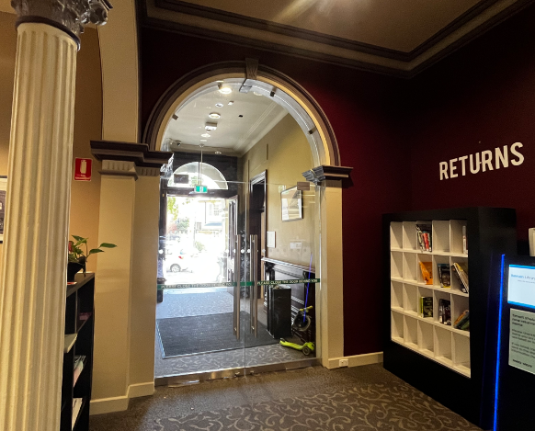
Balmain Town Hall
In Procurement for Construction
New accessible entrance
Reconfigured internal accessible toilet
Accessibility improvements

Slide 14
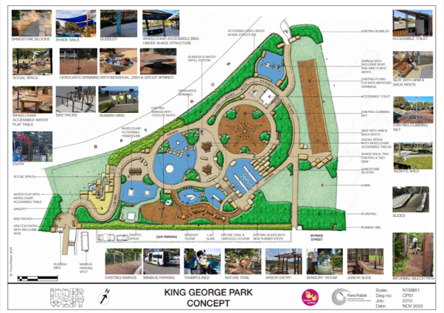
King George Park – Inclusive Playground
In Design
New inclusive playground and accessible toilet.

Slide 15
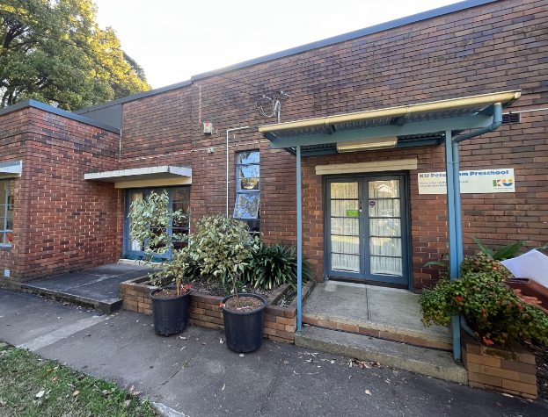
Petersham KU Kindergarten
In Design
New main entry access ramp

Slide 16
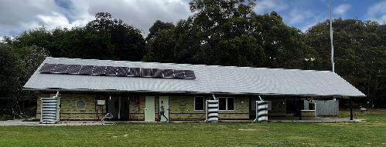
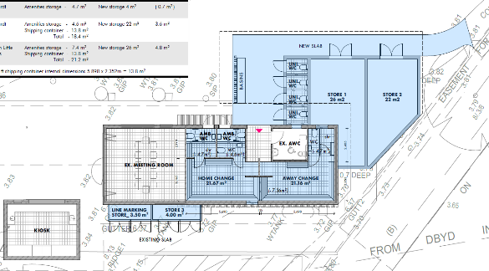
King George Park Amenities
Scoping
Ambulant & public toilets, wash basin,
change facilities and storage rooms.

Slide 17
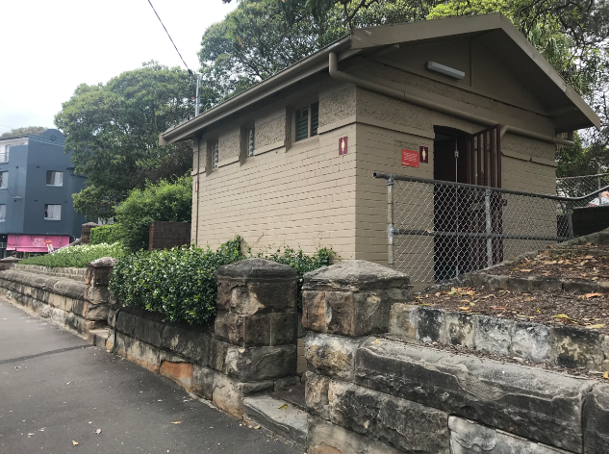
Gladstone Park – New Toilet
Scoping
New toilet near children’s playground
Fully accessible and ambulant toilets

Slide 18
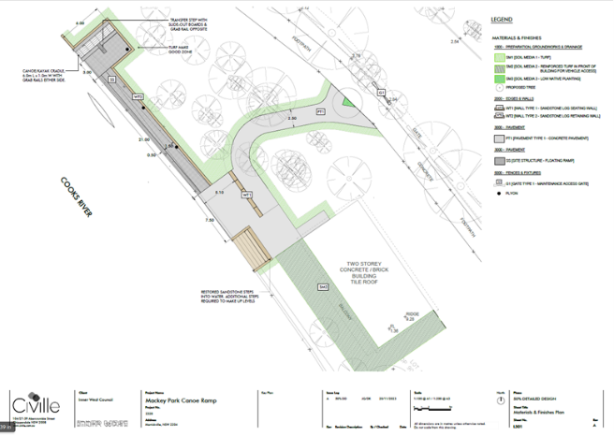
Mackey Park Canoe Club Ramp
In Design
Accessible canoe/kayak water access ramp with paths of travel

Slide 19
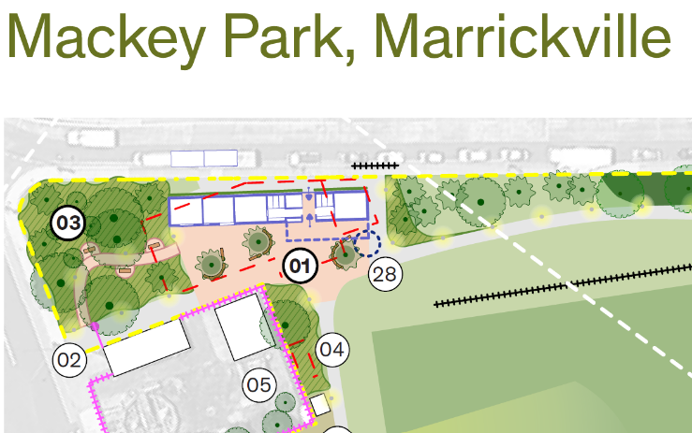
Mackey Park Amenities
Scoping
Replace existing amenities with a new facility to invite entry from Carrington Road as per Draft Master Plan

Slide 20
Projects for Discussion

Slide 21
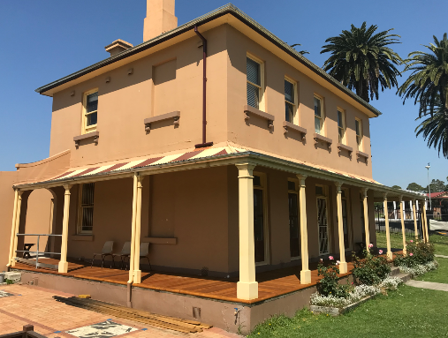
Thirning Villa & Pratten Park Renewal Works
FY24/25 $65K
FY25/26 $500K

Slide 22
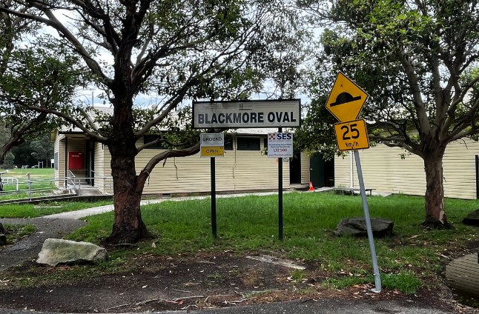
Blackmore Park Renewal Works
Amenities Block A FY23/24 $40K, FY24/25 $330K
General Renewal Works
FY23/24 $30K, FY24/25 $170K

Slide 23
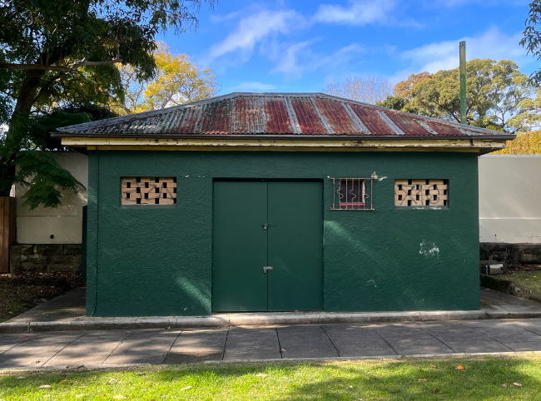
Hoskins Park Toilet Renewal
FY24/25 $100K

Slide 24
PAMP Update
$8m total budget over 4 years
$2m budget this financial year split:
- $1m on kerb ramps
- $1m on raised pedestrian crossings
Completed 100 Kerb Ramps and 5 Raised Pedestrian crossings to date

Slide 25
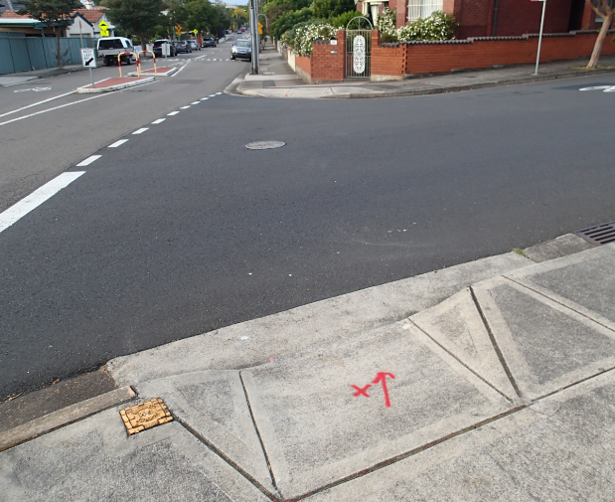
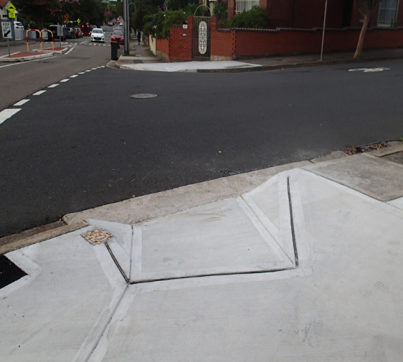
Church Street, Croydon

Slide 26
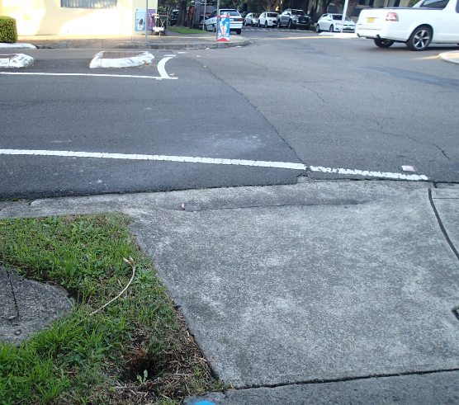
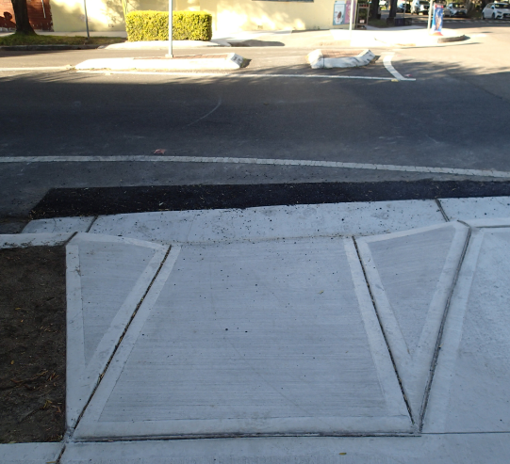
Cnr Northumberland Ave and Albany Rd

Slide 27
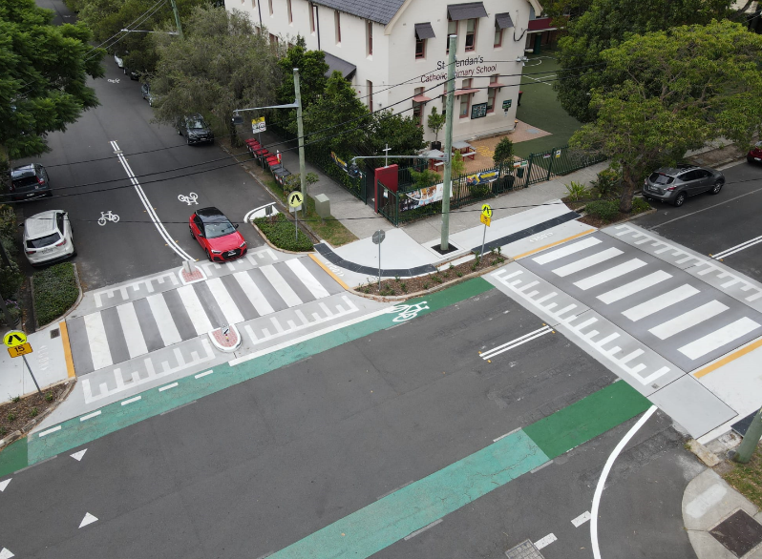
Collins and Trafalgar Street, Annandale

Slide 28
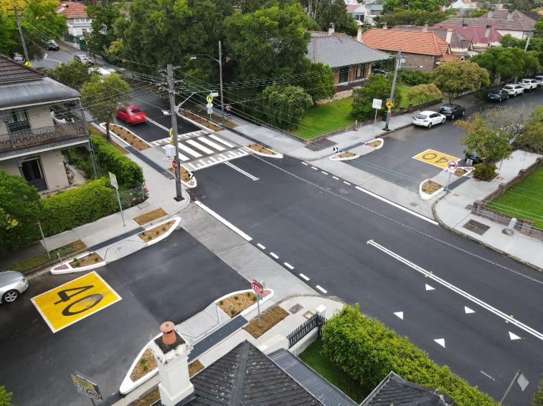
Toothill Street, Lewisham

