Slide 1
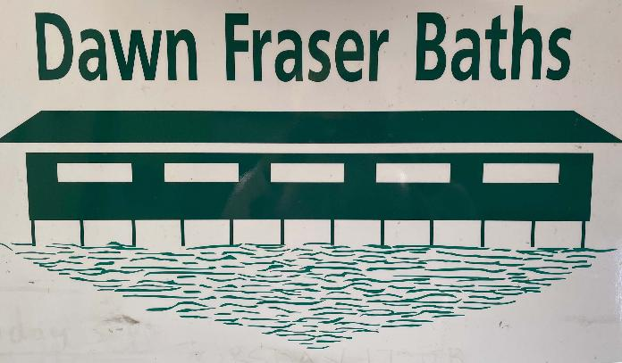
Elkington Park, White Horse Point &
Fitzroy Ave Reserve, Balmain

Slide 2
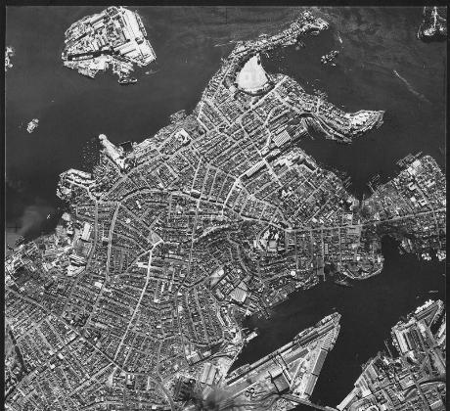
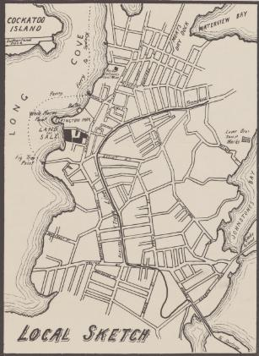
The Sydney suburb of Balmain & Cockatoo Island. Aerial photo taken for the military in 1951.
https://www.flickr.com/photos/angeljim46/8337835240
Carieville Estate, White Horse Point adjoining Elkington Park / for auction sale ... Saturday 13th March 1897, National Library collection
https://catalogue.nla.gov.au/Record/3963693

Slide 3
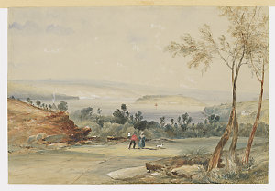
Cockatoo Island near Balmain, John Skinner Prout, 1825 – 1876, SLNSW collection
https://collection.sl.nsw.gov.au/record/YRlZqDgn/jeQ2Rxkzq2jel
An elderly resident recalls Balmain in 1841:
“... the trees were not tall and straight, but rather of the nature of shrubs (ti-tree prevailing I think). Wild flowers grew in abundance ...”
https://nla.gov.au/nla.obj-294960525/view?partId=nla.obj-294960605

Slide 4
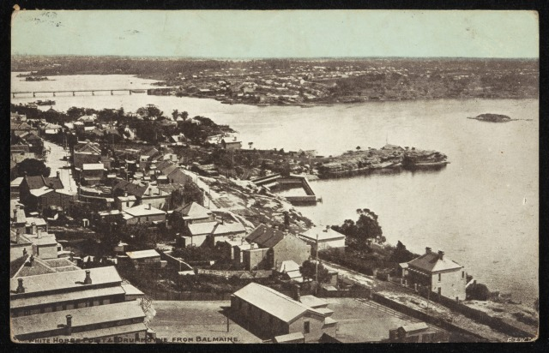
Drummoyne
White Horse Point
Elkington Park
Elkington Park Baths
(now Dawn Fraser Baths)
Fitzroy Ave Reserve
White Horse Point & Drummoyne from Balmain, National Museum 1986.0117.0333,
Josef Lebovic Gallery collection 17 April 1906
https://collectionsearch.nma.gov.au/icons/images/kaui2/index.html#/home?usr=CE

Slide 5
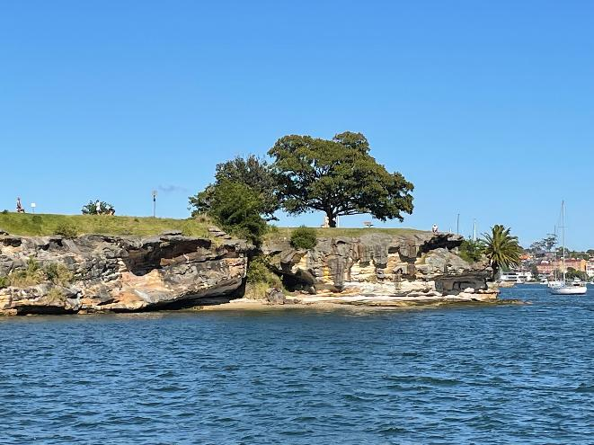
White Horse Point, photograph Helen Nicholson

Slide 6
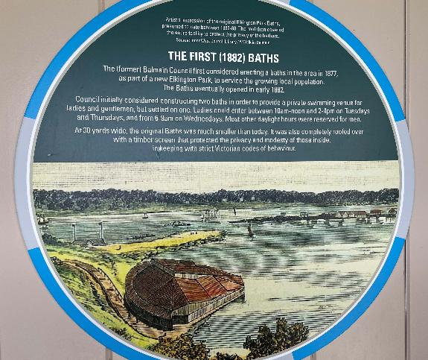
Artist’s impression of the first Baths, interpretation panel Dawn Fraser Baths

Slide 7
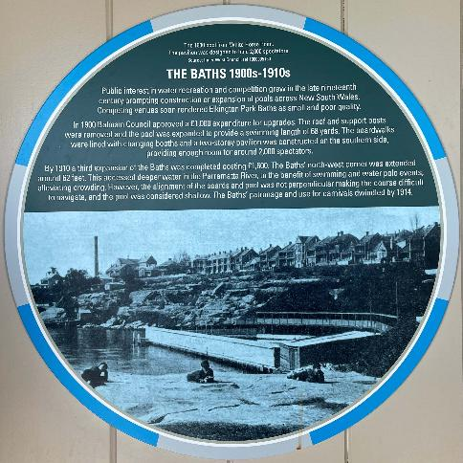
Elkington Park Baths, 1900s – 1910s interpretation panel Dawn Fraser Baths

Slide 8
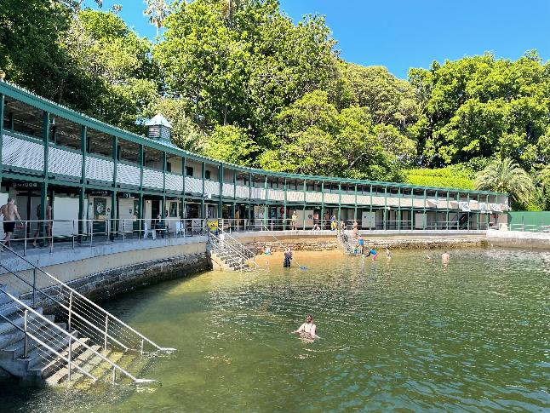
Dawn Fraser Baths, looking west to Elkington Park, photograph Helen Nicholson

Slide 9
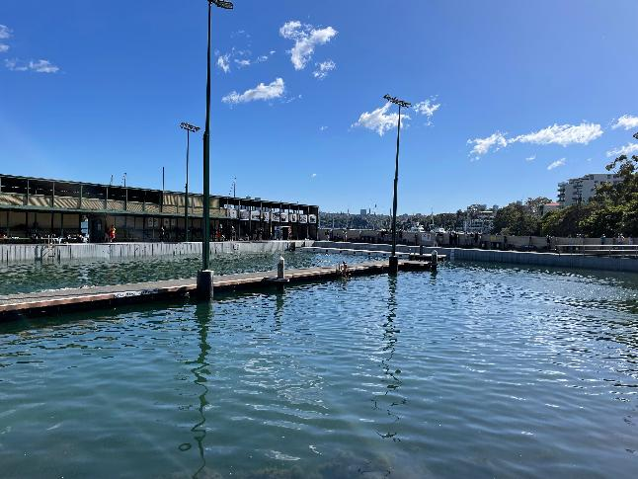
Dawn Fraser Baths, looking north, photograph Helen Nicholson

Slide 10
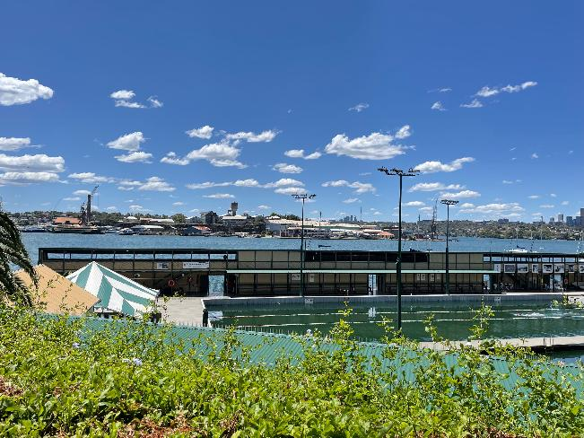
Dawn Fraser Baths, looking north-west to Cockatoo Island, photograph Helen Nicholson

Slide 11
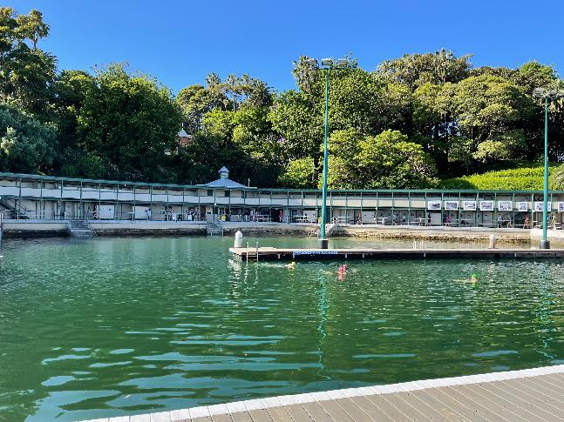
Dawn Fraser Baths, looking south to Elkington Park, photograph Helen Nicholson

Slide 12
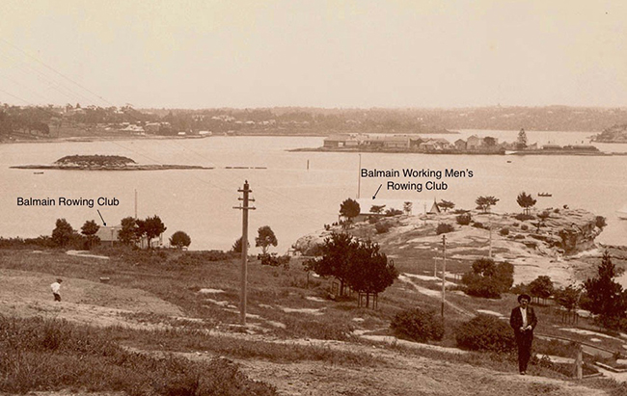
Balmain Working Men’s Rowing Club, c. 1900 (formerly Enterprise Rowing Club)
https://www.bvcvvcxzzzzzzrowinghistory-aus.info/club-histories/balmain-working-mens/formation

Slide 13
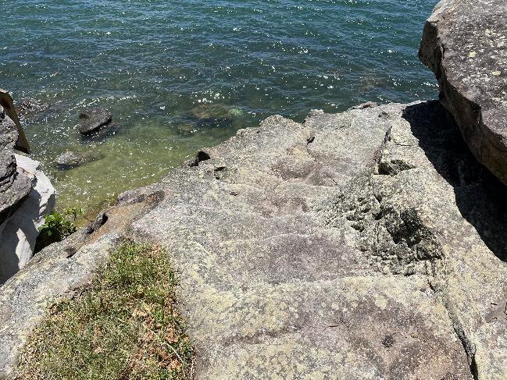
Rock cut steps to now destroyed Balmain Working Men’s Rowing Club, White Horse Point, photograph Helen Nicholson

Slide 14
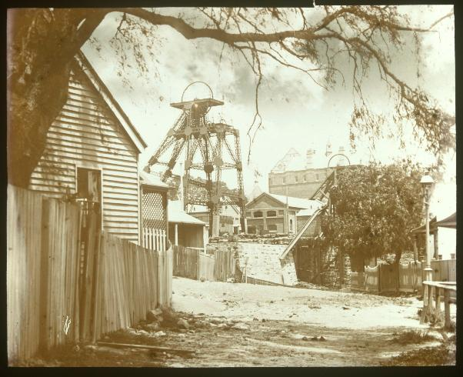
State Library of Victoria, John Henry Harvey, Balmain Colliery, ca. 1920
http://handle.slv.vic.gov.au/10381/75633

Slide 15
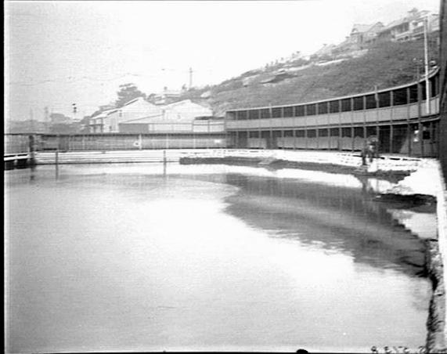
Elkington Park Baths looking east to Fitzroy Ave Reserve, Original negative State Archives & Records Authority of New South Wales. Record Identifier 9ALqQE5Y
https://collection.sl.nsw.gov.au/record/9ALqQE5Y/22Wz74RLVWmad#viewer

Slide 16
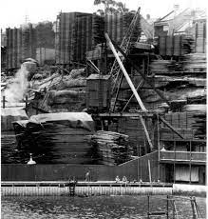
National Box Company & Elkington Park Baths
https://balmainassociation.org.au/newsletters/contents/336September2015.pdf

Slide 17
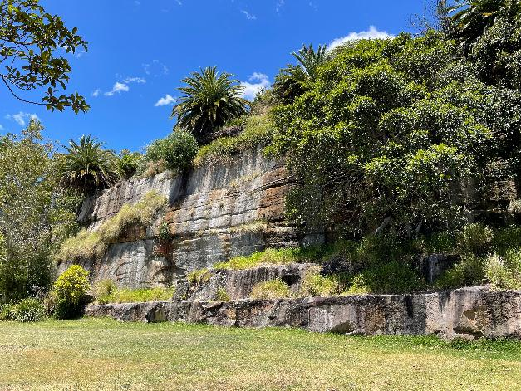
Fitzroy Ave Reserve (formerly the site of the National Box Company) to the east of Dawn Fraser Baths , photograph Helen Nicholson

Slide 18
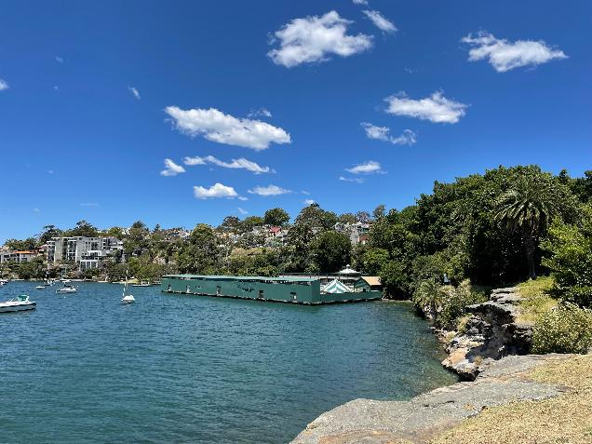
Dawn Fraser Baths, Elkington Park & Fitzroy Ave Reserve from White Horse Point, photograph Helen Nicholson

